Slide 1



Ionic5
Online Workshop
12&13 Nov 2020
9am-12noon
Google Meet

Slide 2
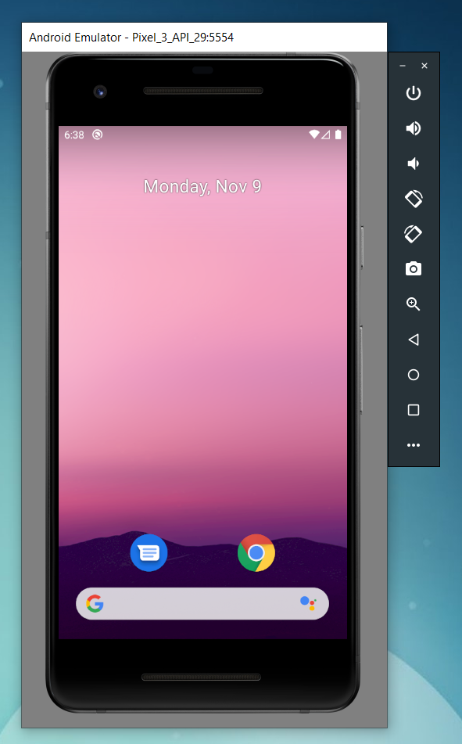

Pengujian apps pada Android Emulator

Slide 3
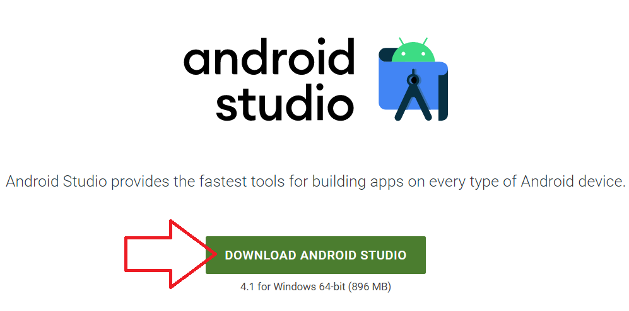
Download Android Studio https://developer.android.com/studio

Slide 4
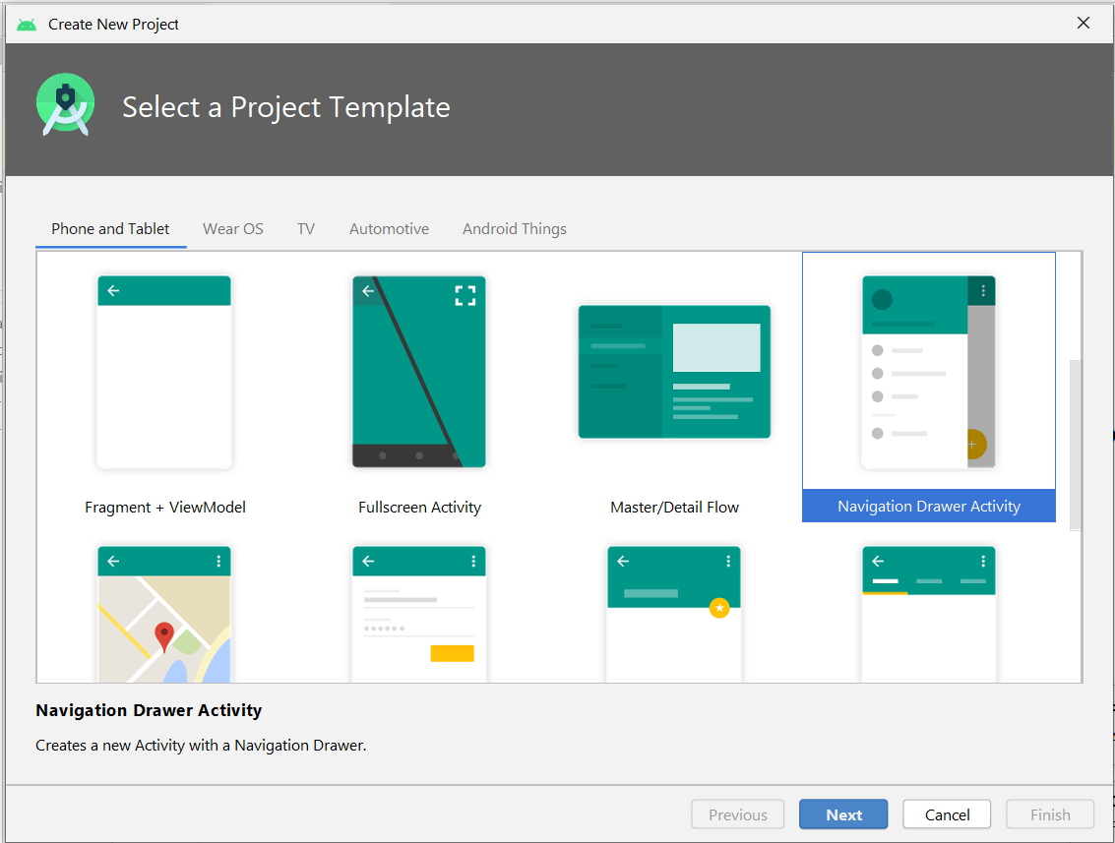
File -> New -> New Project

Slide 5
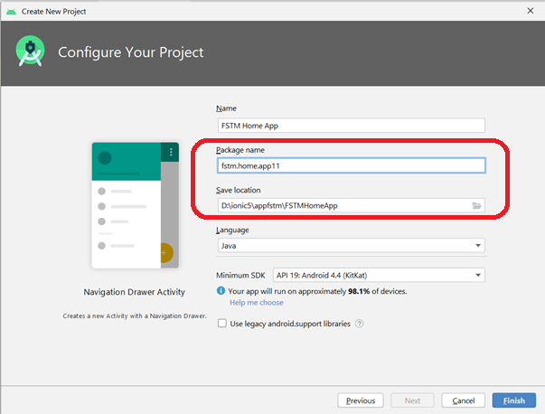
Package name

Slide 6
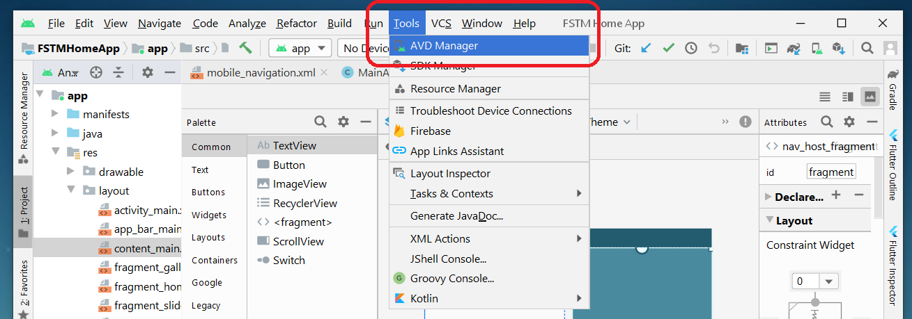
Tools -> AVD Manager

Slide 7
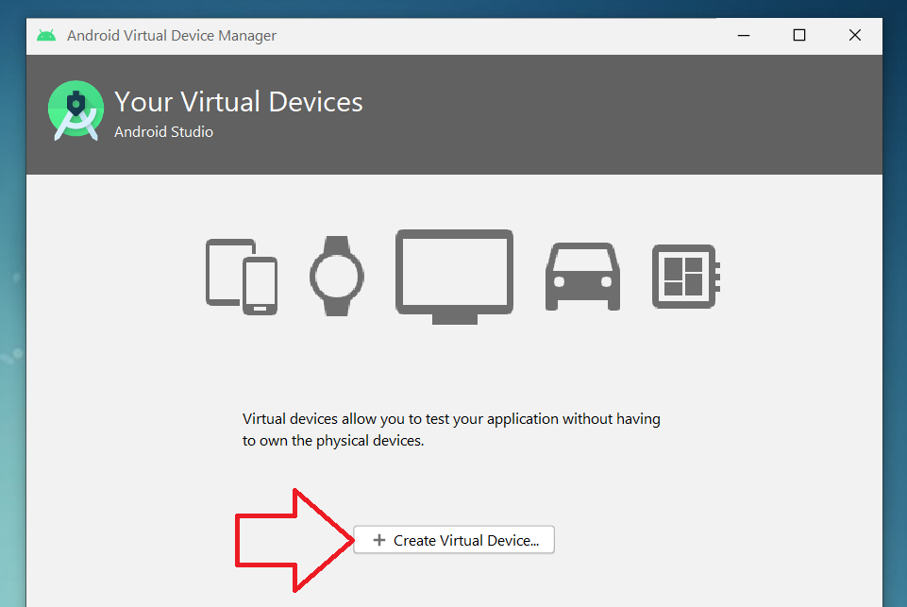
+ Create Virtual Device

Slide 8
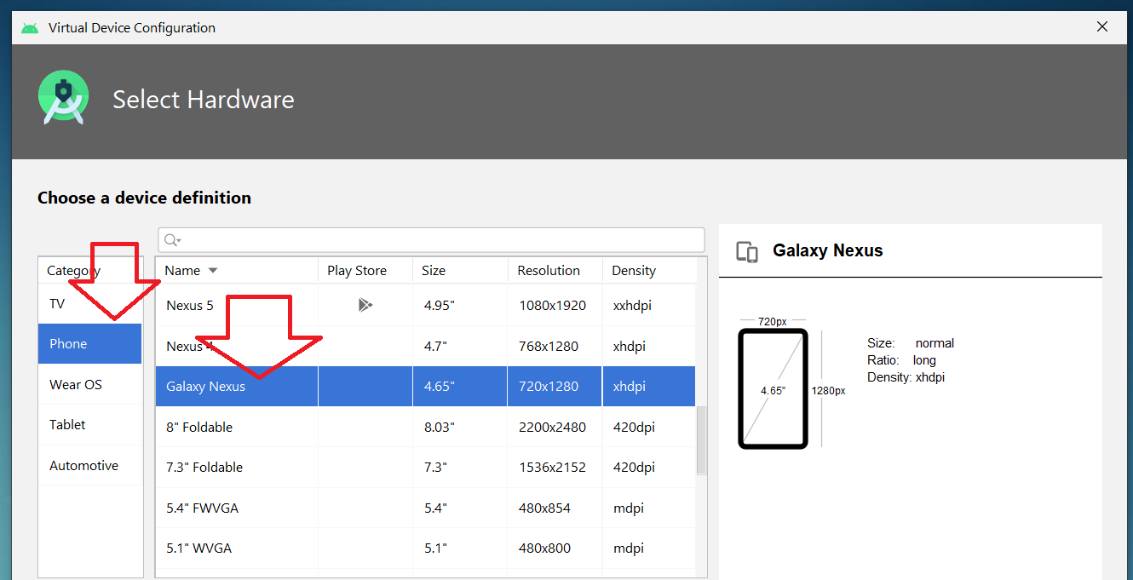
Minimal resolution device

Slide 9
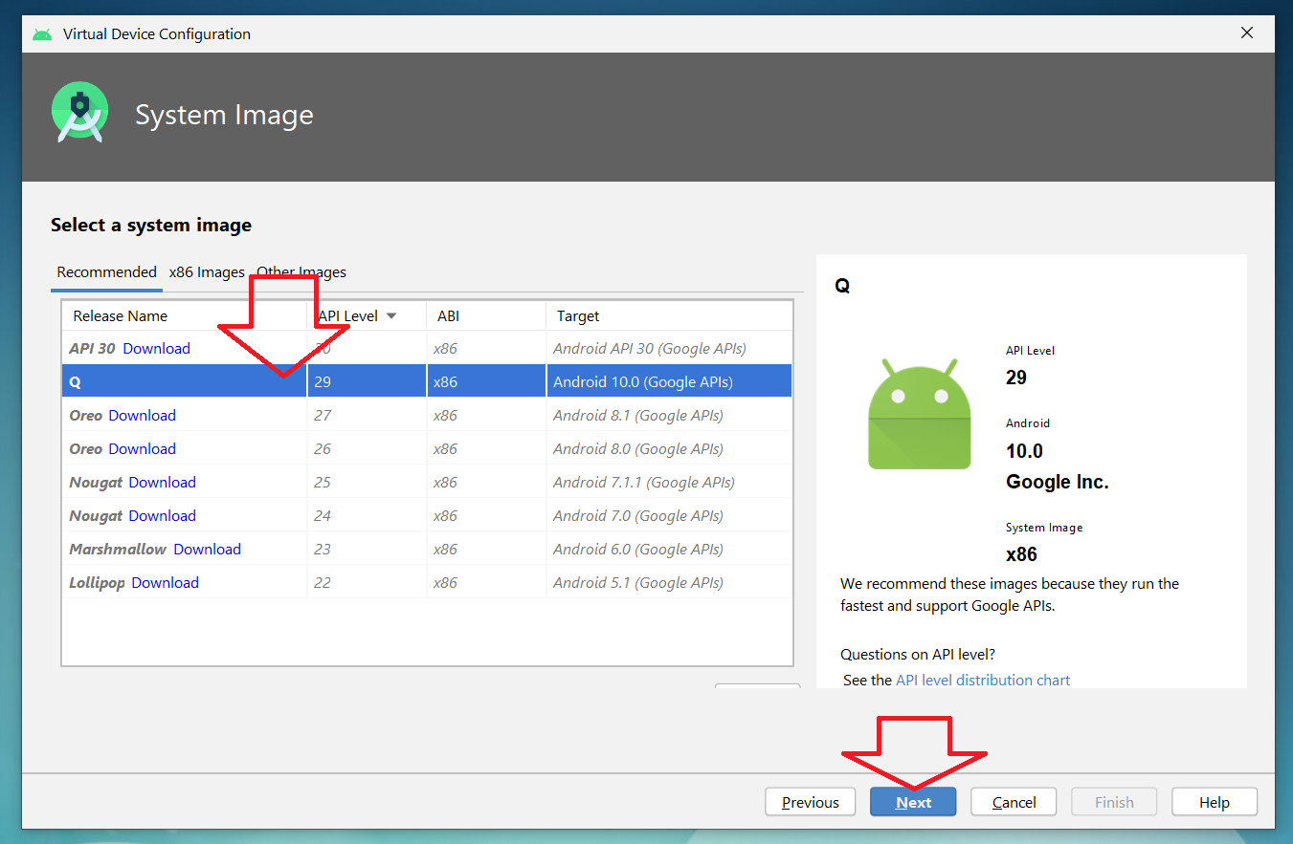
Choose available Android system image

Slide 10
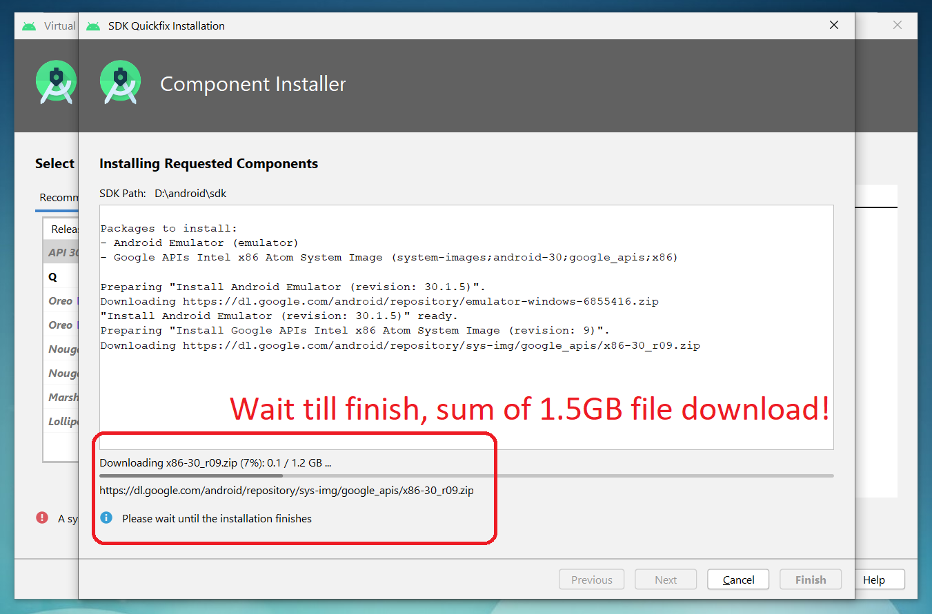
If system image not yet available
Download Android
system image for
1.5GB! (estimation)

Slide 11
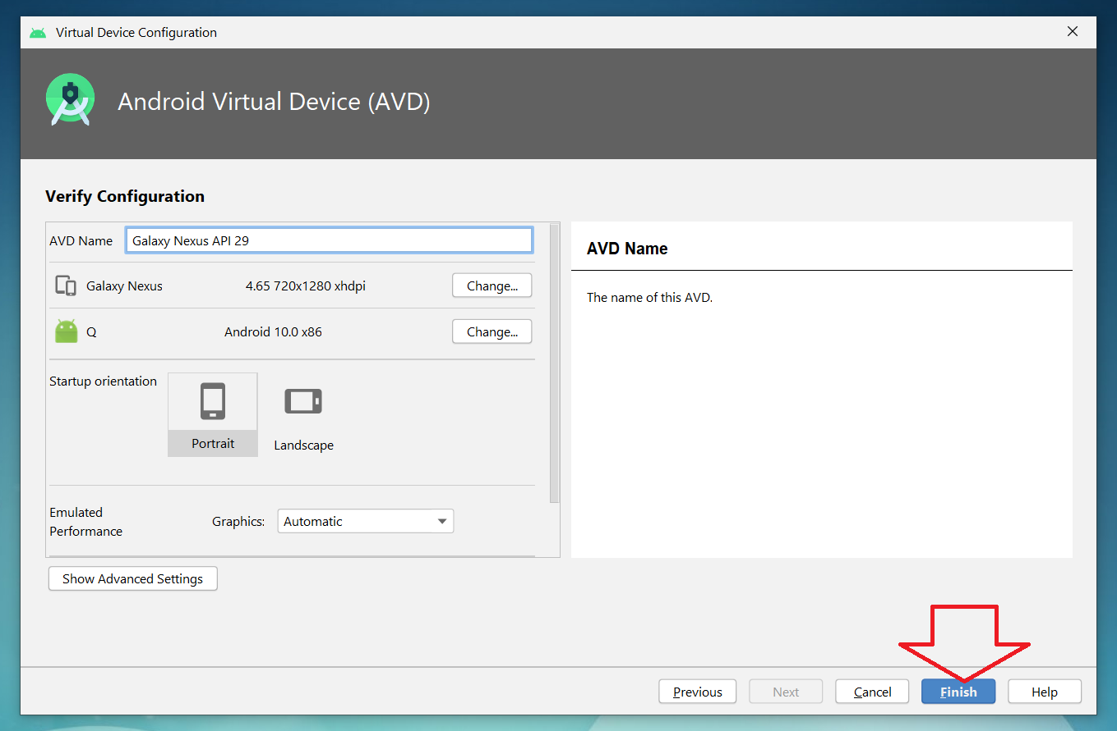
AVD name
Click Finish

Slide 12
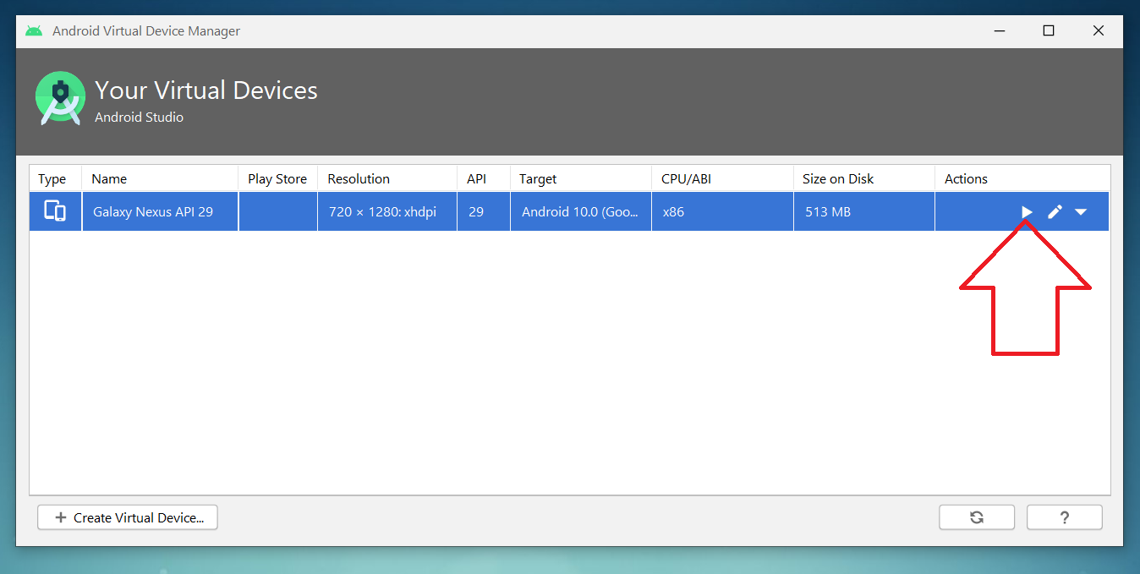
Run Android Virtual Device

Slide 13
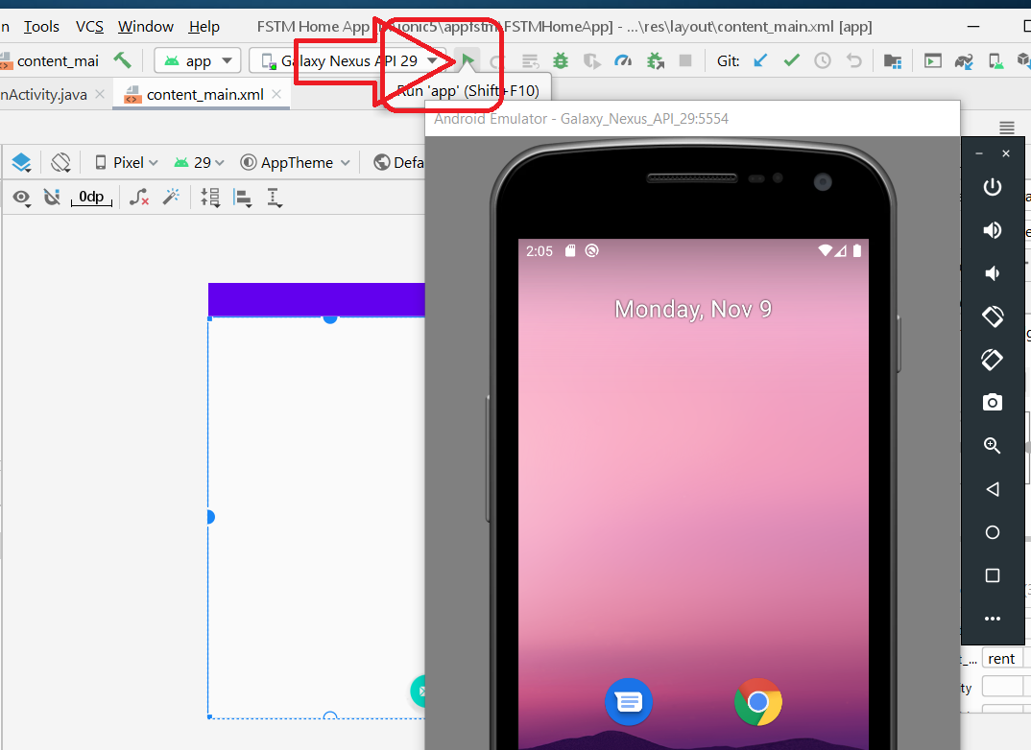
Run
Shift+F10

Slide 14
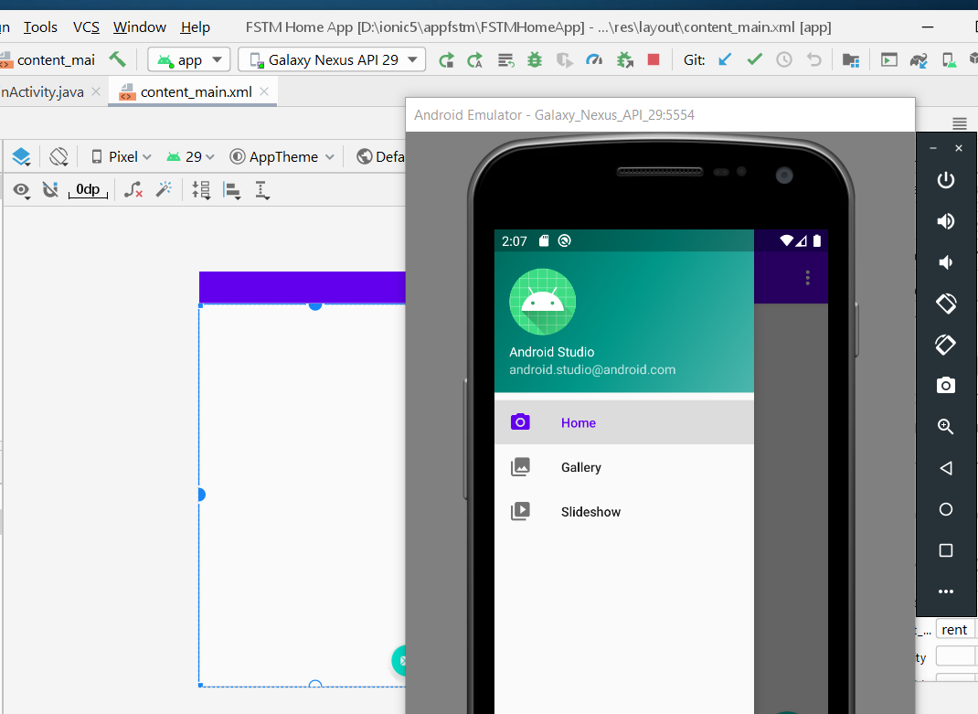
Apps is
Running
On AVD

Slide 15

Slides & materials github.com/khirulnizam/ionic5

Slide 16
Ionic T01 Intro

Slide 17
OVERVIEW
TO IONIC FRAMEWORK

Slide 18

What is Ionic?
Ionic Framework is an open source UI toolkit for building performant, high-quality mobile and desktop apps using web technologies (HTML, CSS, and JavaScript).

Slide 19
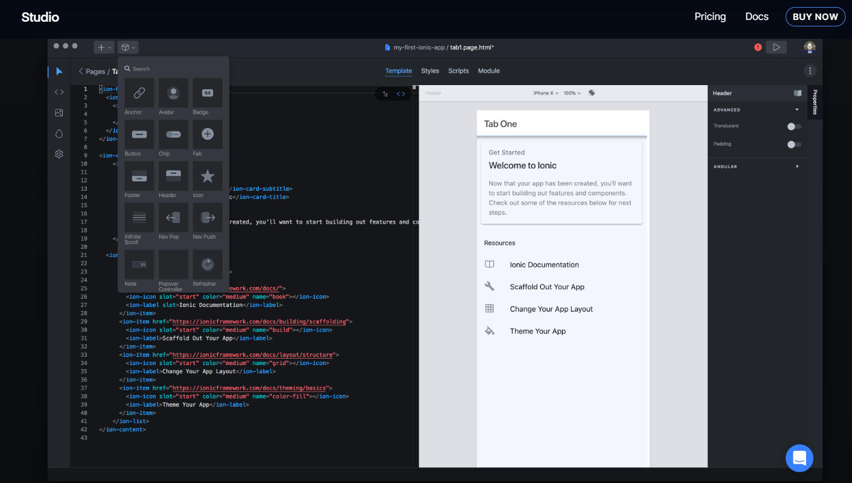
Ionic Studio

Slide 20
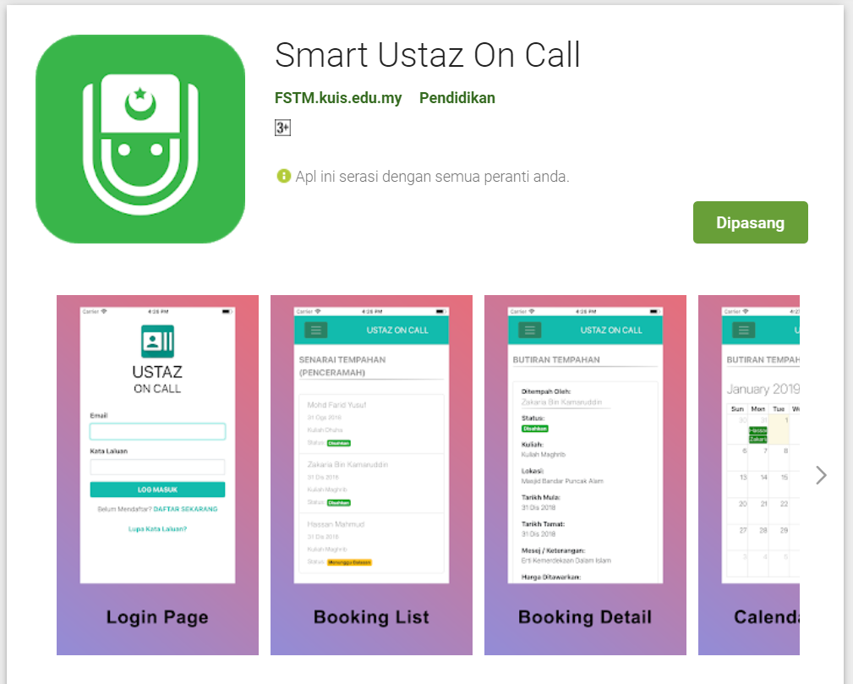
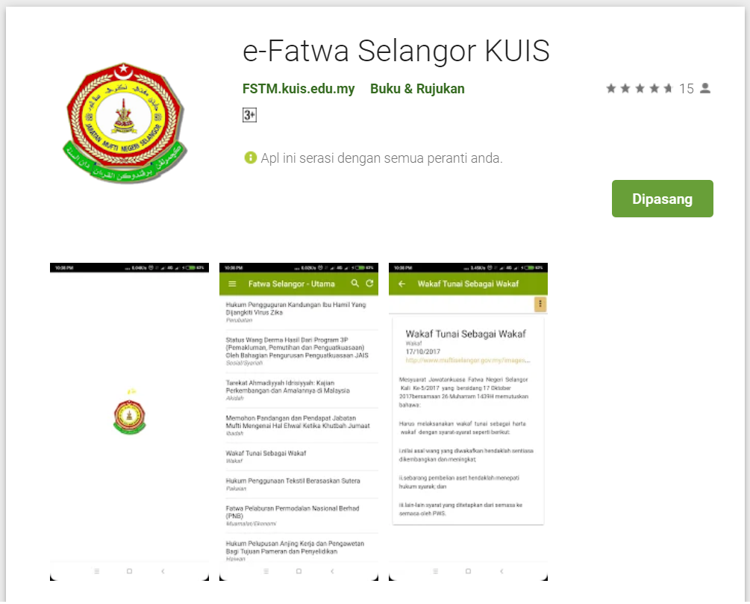
Available apps

Slide 21
IOS & Android Software Development
In a nutshell

Slide 22





Android Studio
(Java & Kotlin)
Android Device
NATIVE - 2 X WORK
XCode (Swift & Objective C)
iPhone/iPad

Slide 23

1 x WORK
Compile with Android SDK
Android Device
Cordova
Framework
Hybrid
XCode Project
iPhone/iPad

Slide 24
Cordova
Framework
Hybrid
WEB LAYER
NATIVE APP

Slide 25
1 x WORK
Build Progressive Web Apps
Android Device
Build Progressive Web Apps
Cordova
Framework
Hybrid
iPhone/iPad

Slide 26


1 x WORK
Android Studio
Android Device
+
XCode
iPhone/iPad

Slide 27
https://capacitor.ionicframework.com/

Slide 28



WHY IONIC?
Framework specifically to develop apps
Multiple platforms-Android, IOS, Windows, Amazon etc
Apps development using HTML & Typescript (subset of Javascript)
Plugins (camera, thumbprint, bluetooth, printer etc etc etc)

Slide 29
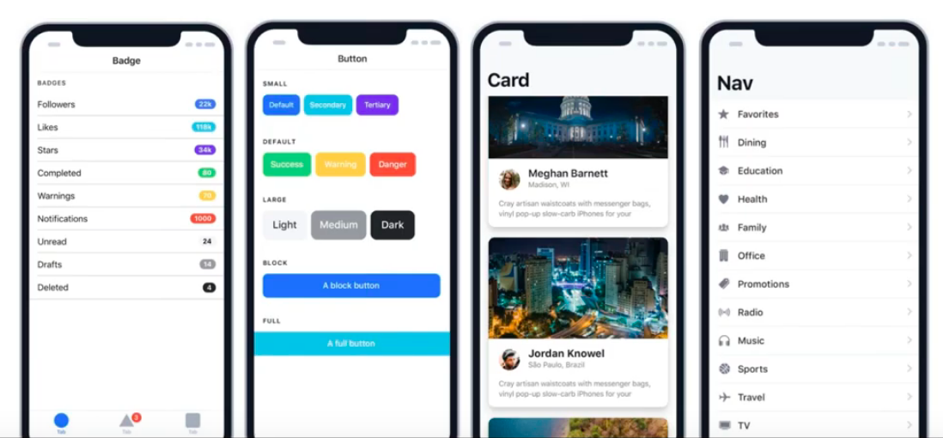
WHY IONIC?
Large COMMUNITY for support
Pre built gestures & animation
100+ UI Components
Everything is OPEN SOURCE
Built with Ionic

Slide 30
Software to start Ionic?

Slide 31
What do you need?
To run IONIC:
Node Package Manager (NPM)
Ionic Cordova Framework
Google Chrome Web Browser
To develop/publish app
VSCode OR any other IDE (with Typescript Plugin)
Ionic Capacitor
Android SDK or Xcode - can be done later

Slide 32
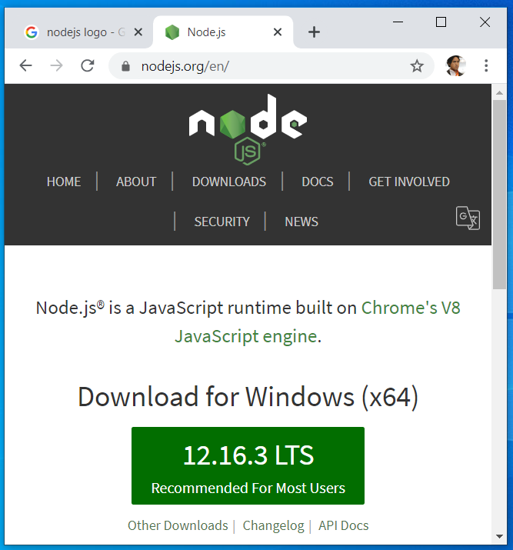

Download from nodejs.org
Download and install the LTS version
http://nodejs.org

Slide 33
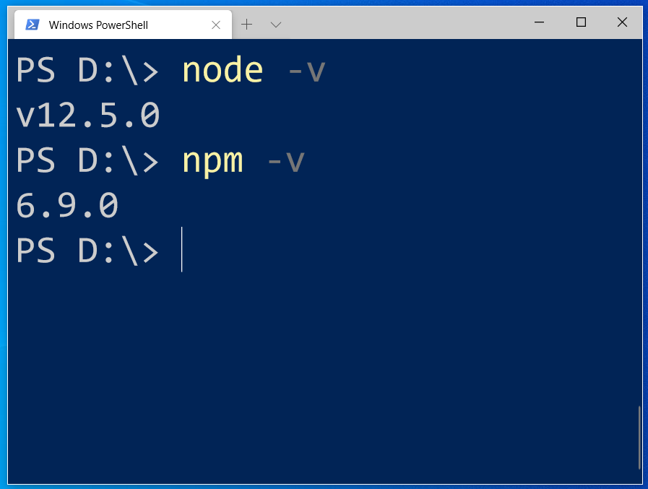
After install NodeJS from nodejs.org
node -v
npm -v

Slide 34
2. From command terminal run:
npm install -g ionic cordova

Slide 35
Now, let’s install the tools

Slide 36
Install VSCode/sublime
NodeJS
Tutorial is here bit.ly/ionickerul
Install Google Chrome Browser
(If you don’t have, you should)

Slide 37
Before we start coding, some basic stuff...

Slide 38
-HTML?
-CSS ?
-TypeScript ?

Slide 39
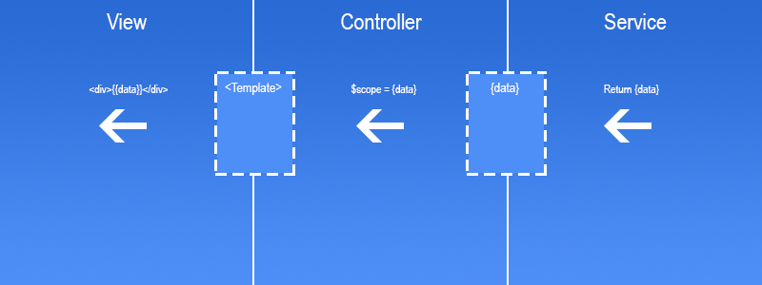
Simple MVC in Ionic
.HTML | .TS | services .TS /Model

Slide 40
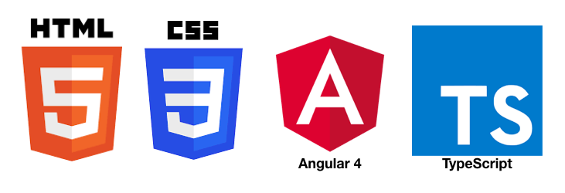
HTML
-Hyper Text Mark Up Language (HTML)
-Used to display the interface
-Write in tags,
-Example- <strong>Hello</strong> → Hello
-Ionic has its own built in tags
<ion-list></ion-list>
<ion-item></ion-item>
<ion-grid></ion-grid>
-HTML in Ionic is “AngularJS Flavoured”
-Have to use Angular Syntax for data and clicks
-Example- (click), *ngFor etc

Slide 41
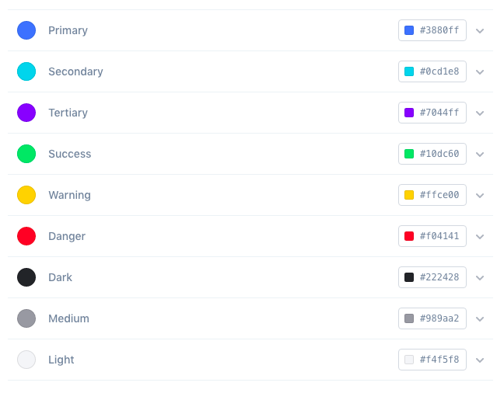
CSS or SCSS
-Cascading Style Sheets (CSS)
-Used for styling, very straightforward
-Each generated Ionic page comes with built in own CSS
-Can assist in ‘theming’ the app
-Ionic has standard built in colours
-Primary, Secondary, Danger, Light & Dark
Built in colours that can be added/edited

Slide 42
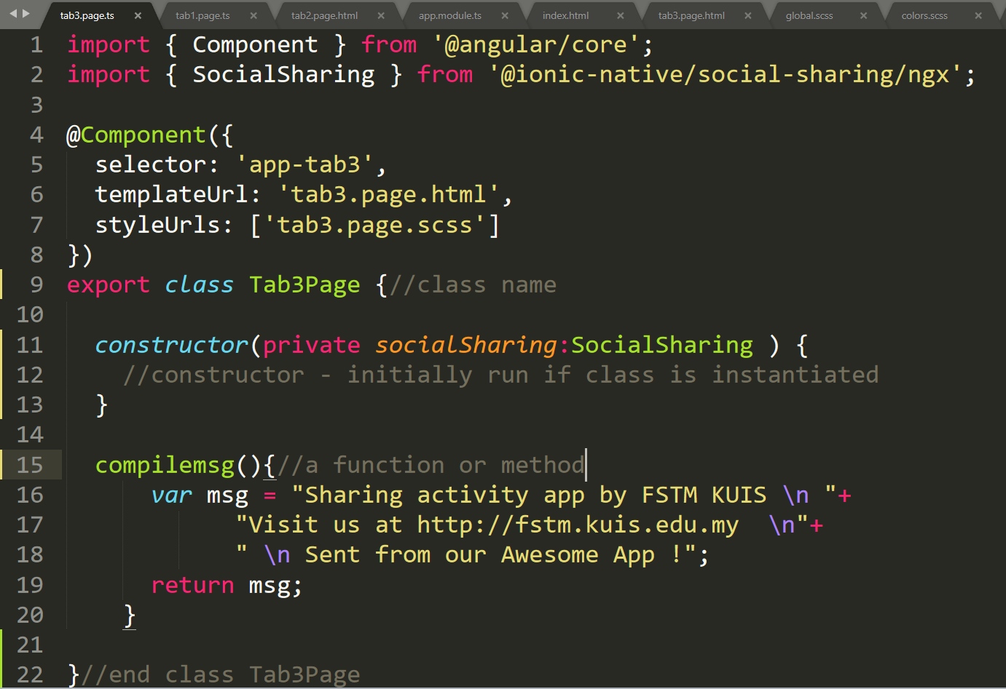
Class Function

Slide 43
Hello World ionic

Slide 44
1. Start a project
ionic start appfstm tabs

Slide 45
2. CD into Directory & Run the project
ionic serve

Slide 46
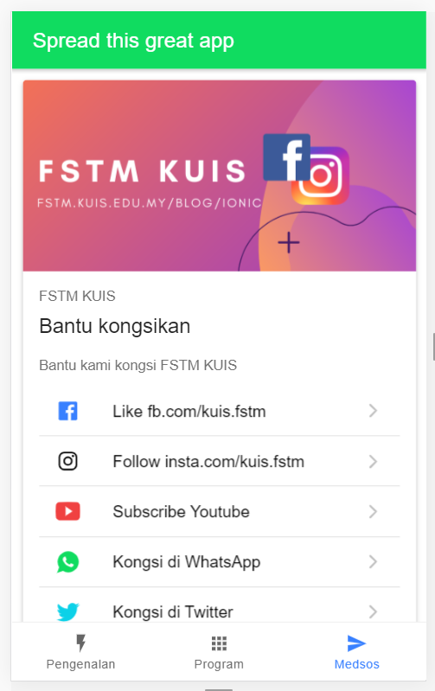
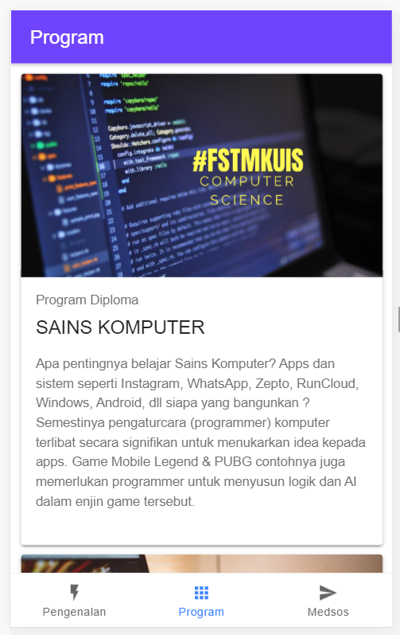
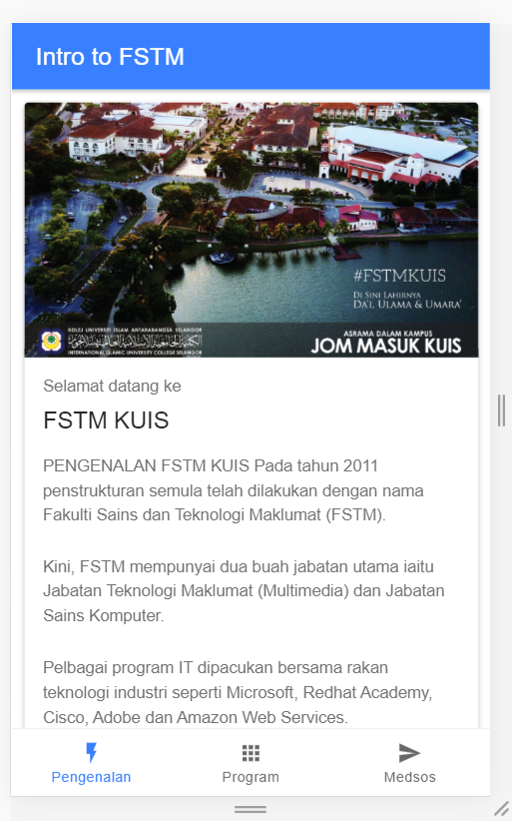
Next tab2 and tab3

Slide 47


T02 HTML interface
(antaramuka)

Slide 48
1. Start a project
ionic start appfstm tabs

Slide 49
2. CD into Directory & Run the project
ionic serve

Slide 50
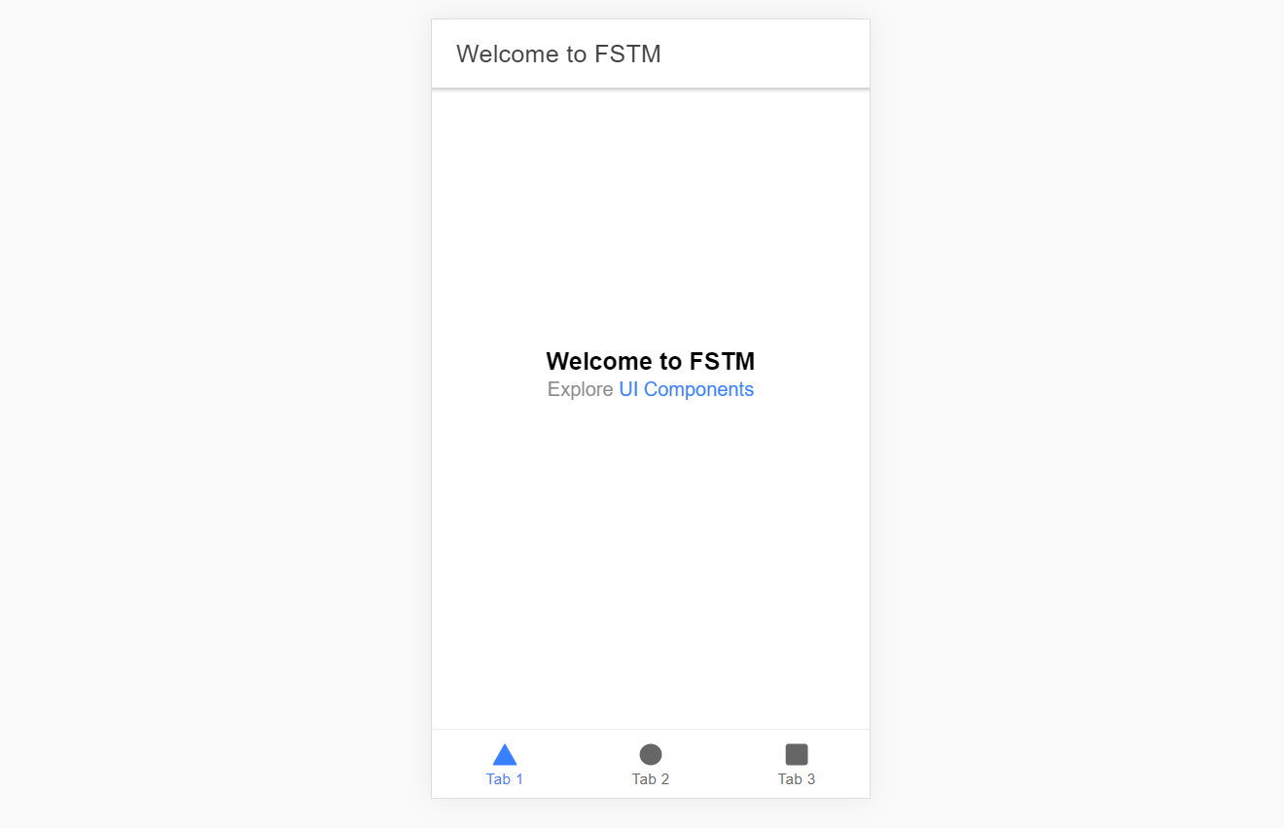
Output : ionic serve

Slide 51
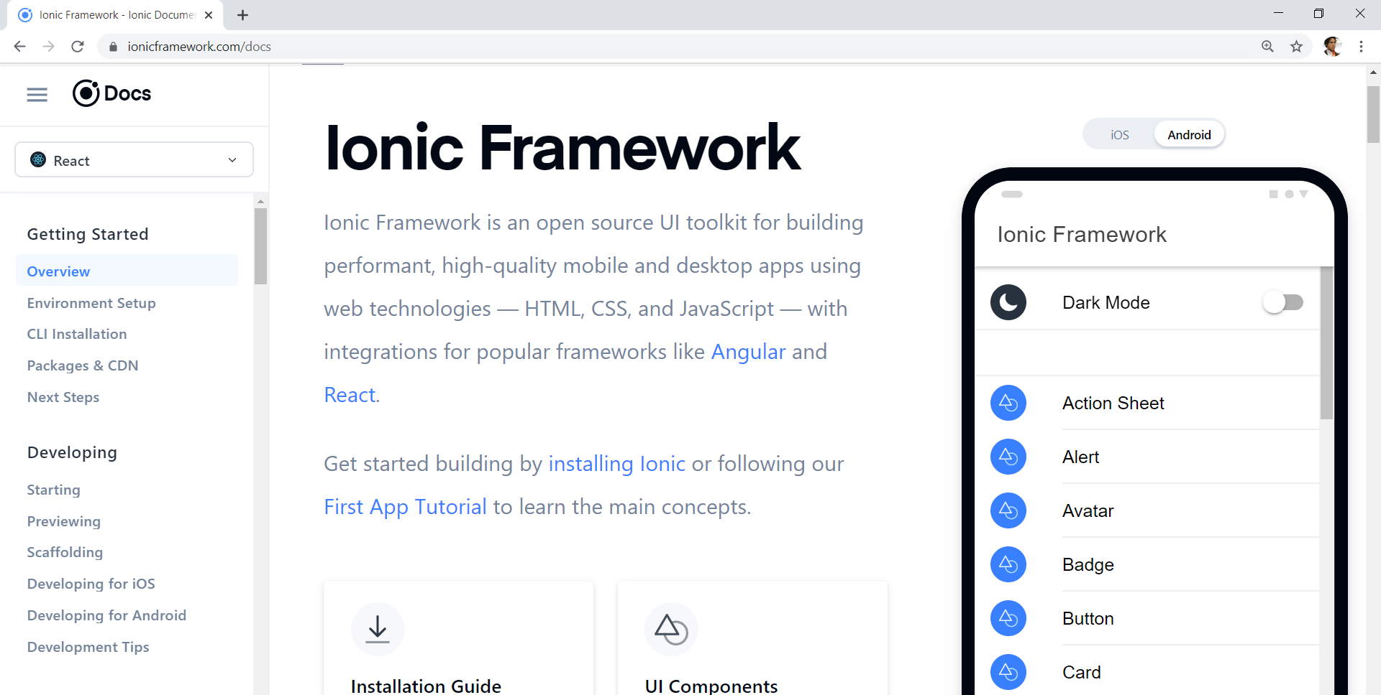
Always refer to documentations: https://ionicframework.com/docs

Slide 52
HTML
-Hyper Text Mark Up Language (HTML)
-Used to display the interface
-Write in tags,
-Example- <strong>Hello</strong> → Hello
-Ionic has its own built in tags
<ion-list></ion-list>
<ion-item></ion-item>
<ion-grid></ion-grid>
-HTML in Ionic is “AngularJS Flavoured”
-Have to use Angular Syntax for data and clicks
-Example- (click), *ngFor etc

Slide 53
CSS or SCSS
-Cascading Style Sheets (CSS)
-Used for styling, very straightforward
-Each generated Ionic page comes with built in own CSS
-Can assist in ‘theming’ the app
-Ionic has standard built in colours
-Primary, Secondary, Danger, Light & Dark
Built in colours that can be added/edited

Slide 54
Next tab2 and tab3

Slide 55
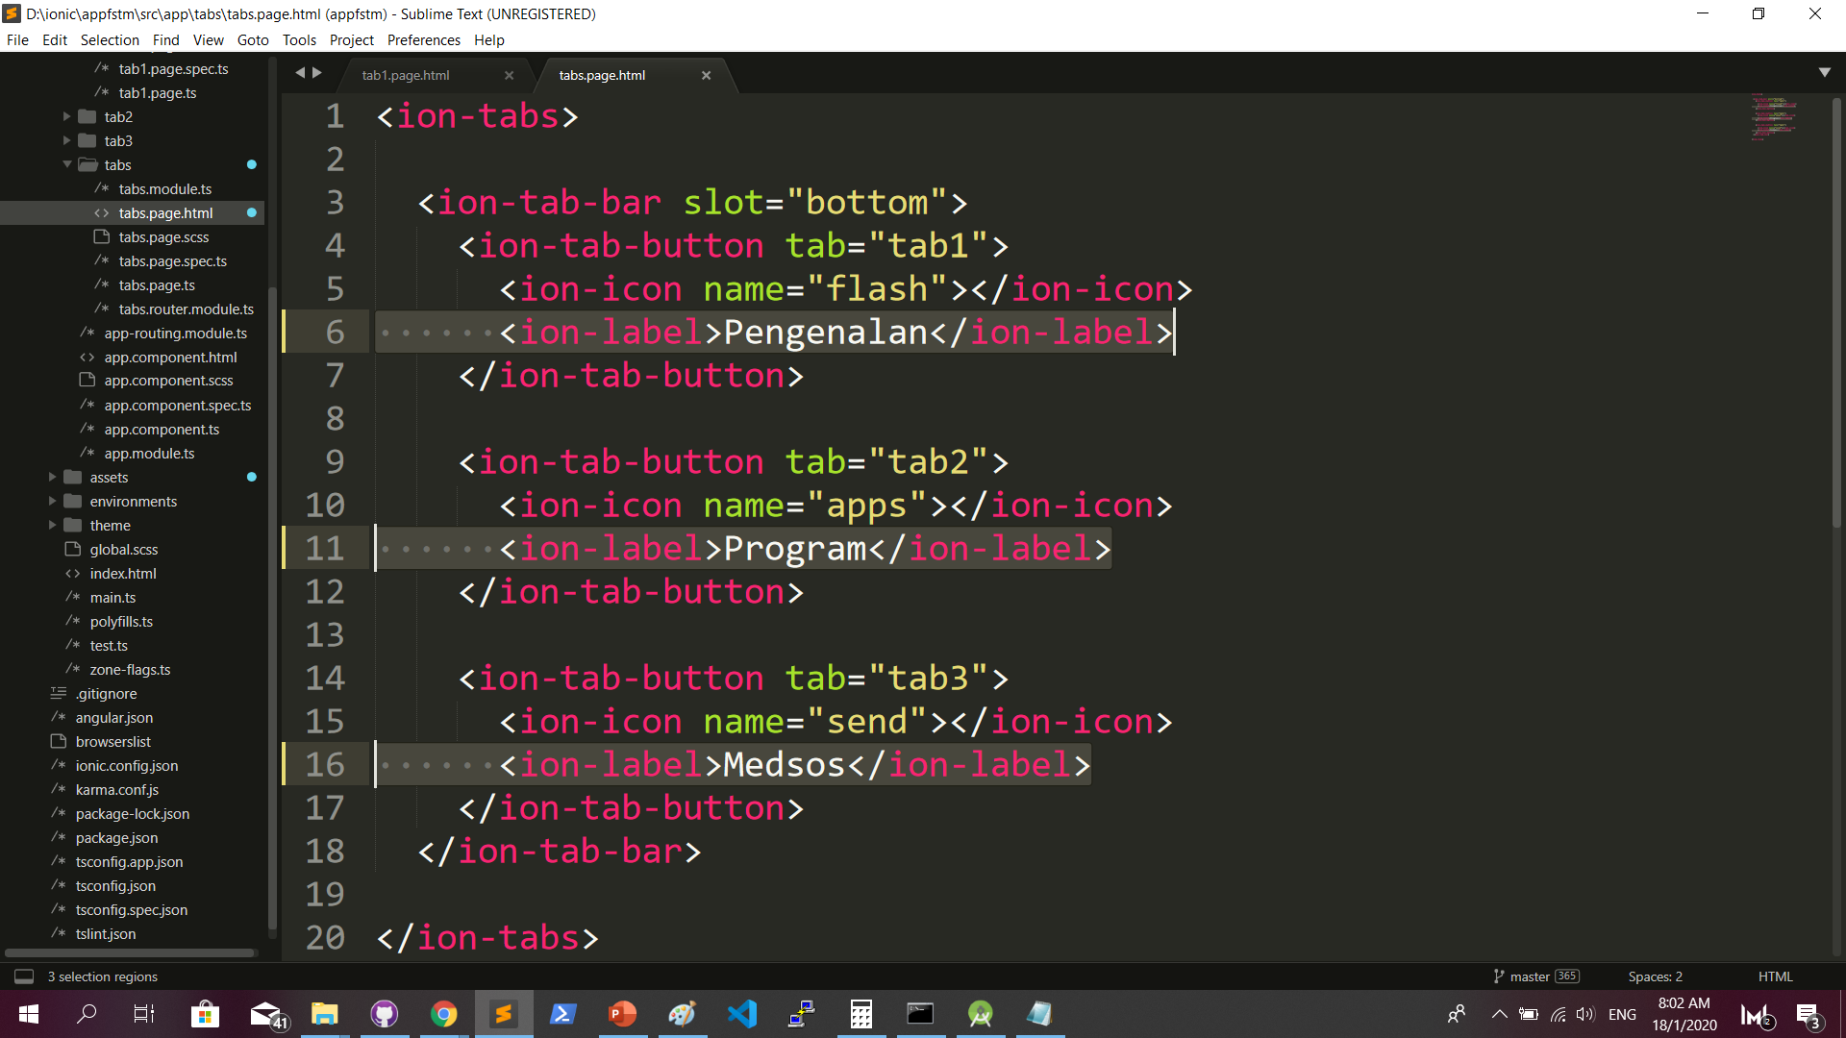
Some interface cosmetics: src/app/tabs/tabs.page.html

Slide 56
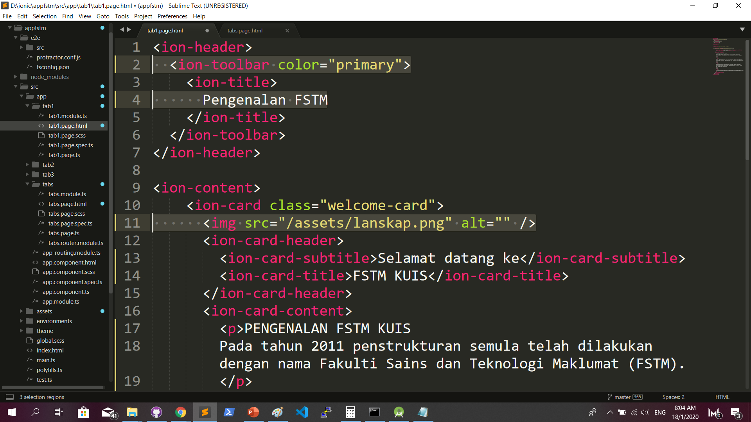
More interface cosmetics: src/app/tab1/tab1.page.html

Slide 57
Run ionic serve

Slide 58
Next tab2 and tab3

Slide 59
Codes & slides github.com/khirulnizam/ionic5

Slide 60
T03 Navigasi
(page navigation)

Slide 61
Page Navigation
+ routerLink (in .html) + NavController (in .ts)

Slide 62
routerLink in HTML
PAGE 1
PAGE 2
See app-routing.module.ts for page name

Slide 63
Exercise : Link to new page
Generate new pages
ionic g page info
ionic g page form

Slide 64
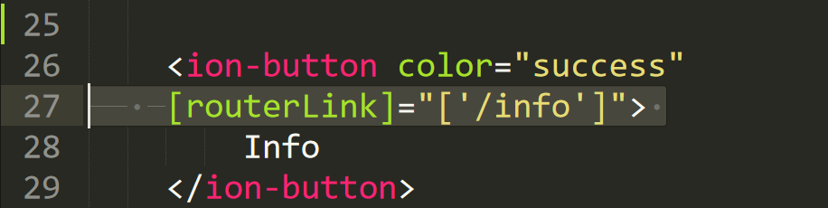
Exercise : Link to new page

Slide 65
NavController in TS
PAGE 1
PAGE 2
See app-routing.module.ts for page name

Slide 66
Add simple form interaction
+ Form Button + Alert function

Slide 67
Try building a button and make an alert
helloWorld(){
alert(“Hello Ionic!”)
}
<ion-button (click)=”helloWorld()”> ALERT </ion-button>
info.page.ts
info.page.html

Slide 68
Codes & slides github.com/khirulnizam/ionic5

Slide 69

T04 TypeScript

Slide 70
TypeScript
-A subset of Javascript
-Part of ECMA6 standard
-The ‘brains’ behind your app
-Used for processing & handling data
Example- calculation, accessing DB etc
-Ionic has standard built in to its TS:
NavController, ModalController etc

Slide 71
Typescript Syntax : Function
n1:number;
n2:number;
output:any;
addnumbers(){
output=n1+n2;
displayresult( );
}
displayresult( ){
alert(“Output: ”+output);
}

Slide 72
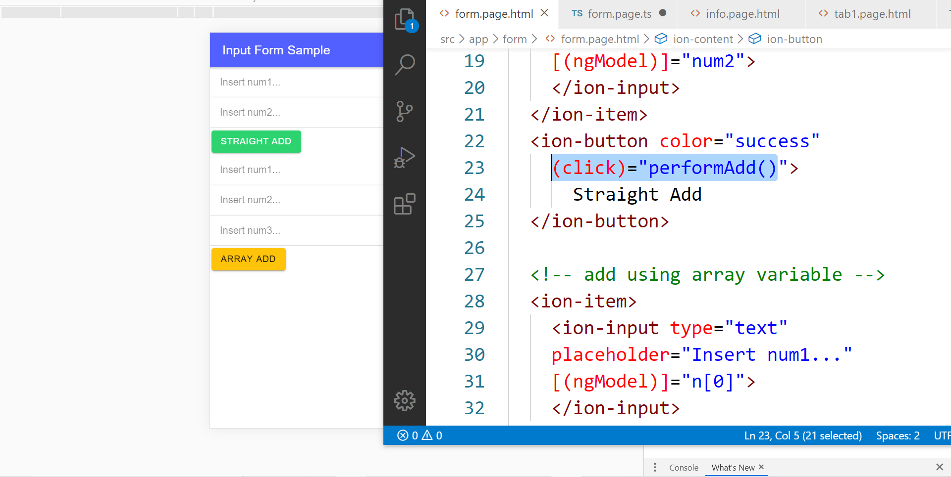
In file .HTML

Slide 73
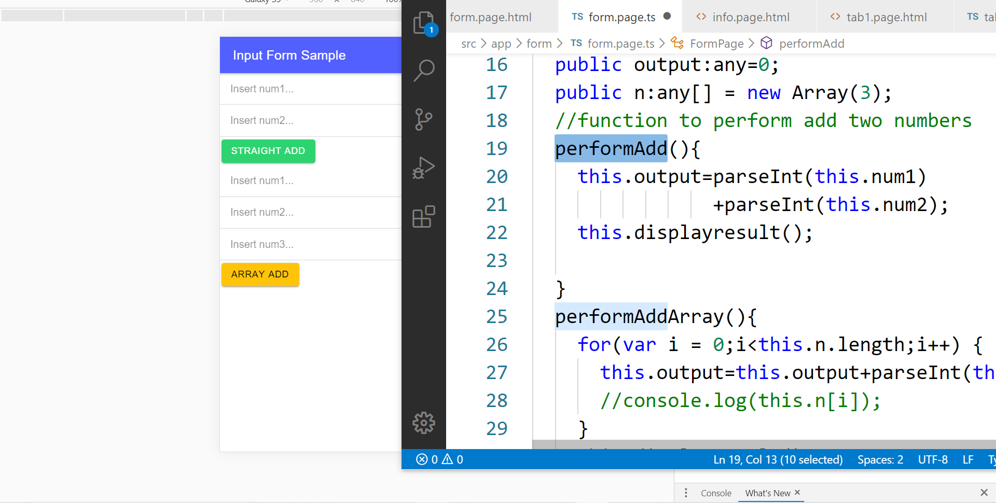
In file .TS

Slide 74
TypeScript Syntax : EX1 variable
What is a variable?
A variable acts as a container for values in a programming code.
var pi:number = 3.14;
Var num1:number=5;
var name:string =“enKerul”;
Use any to loosely-type the variable data type.
Data types:
any
can be numbers or strings
string
“this is string ” + “ concat ”
number
Double 3.14, or integer 5
array
can be a collection of Var, Strings or Objects

Slide 75
Typescript Syntax : EX2 String manipulation & Casting
//to convert String to number
var str = "54";
//easy way by using + operator
var num = +str; var num = parseInt(str);
String manipulation?
var str:string = "3.14";
var pi:number = 3.14;
console.log("pi is "+pi);
console.log("tau is "+(2 * pi));

Slide 76
Typescript Syntax : EX3 Array
Array? Array
can be a collection of Var, Strings or Objects
// A list literal.
var numbers = [4, 1, 5, 6, 3, 2];
for(var i=0;i<numbers.length; i++)
{
sum=sum+numbers[i]);
console.log(“Sum: ”+sum);
}
-----
Output
Sum: 21

Slide 77
Typescript Syntax : EX4 Associative array
Associative Array?
Array with key and value pairs (not index number).
// A map literal.
// Asociative array
var gases = [
'He': 'Helium',
'Ne': 'Neon',
'Ar': 'Argon’,
];
console.log(gases['Ne’]);
-------------------------
Output: Neon

Slide 78


T05 Kamera (installing camera plug-ins)

Slide 79
Codes & slides github.com/khirulnizam/ionic5

Slide 80
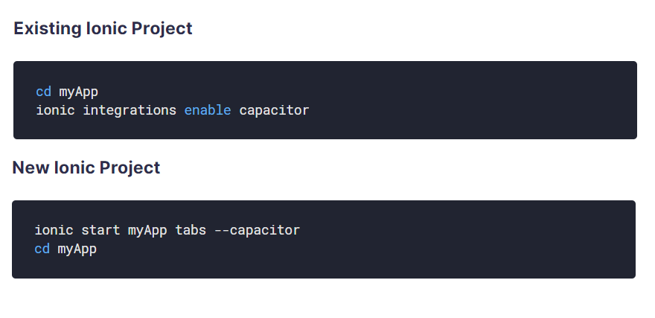
Using Capacitor with Ionic

Slide 81
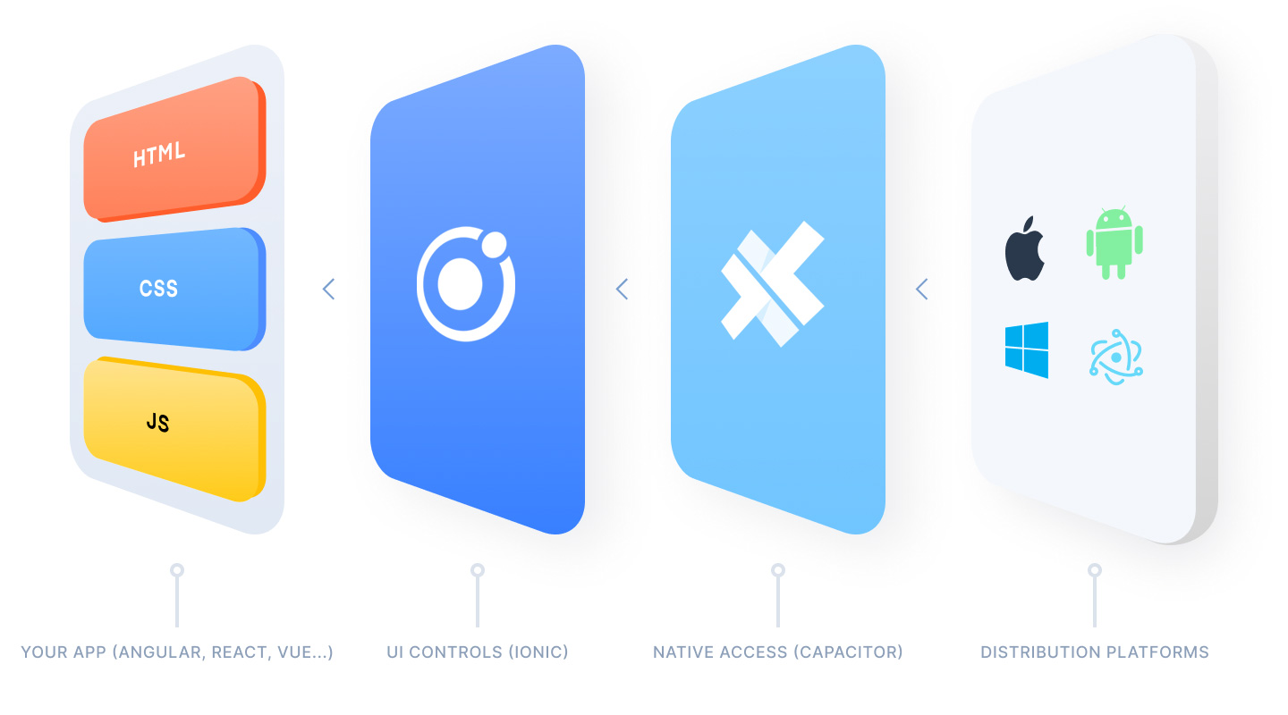
Ionic Capacitor
https://ionicframework.com/resources/articles/capacitor-vs-cordova-modern-hybrid-app-development
runs modern Web Apps natively on iOS, Android, Electron, and Web

Slide 82
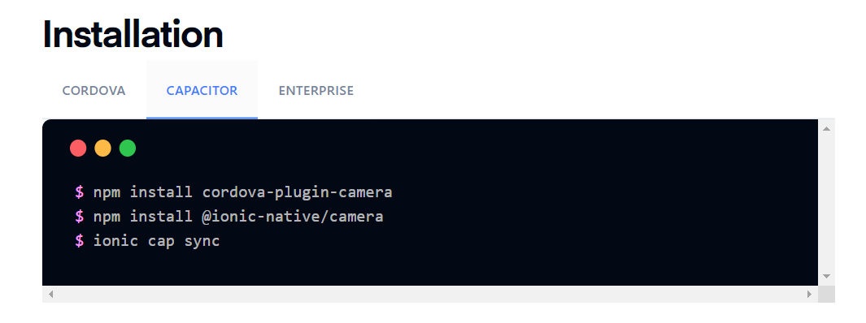
Install camera support : ionicframework.com/docs/native/camera

Slide 83
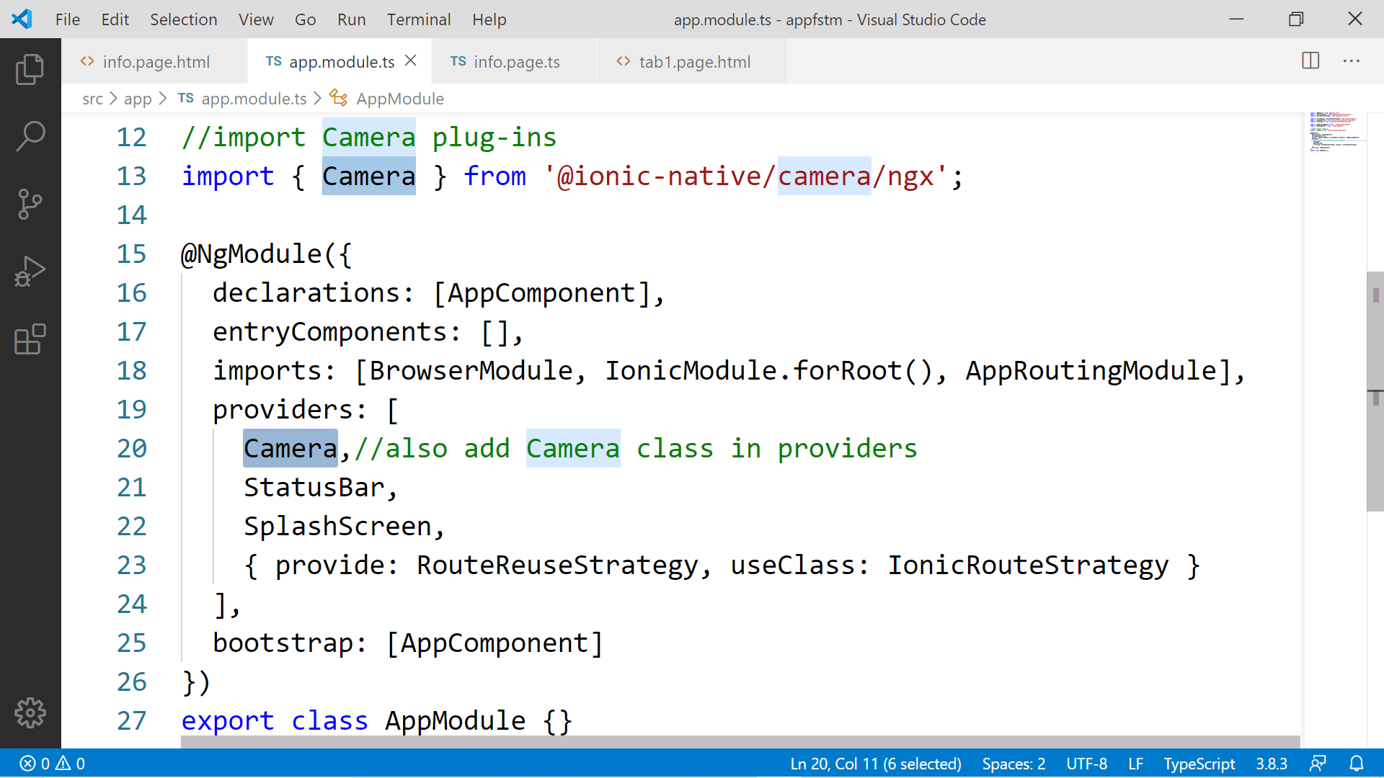

Slide 84
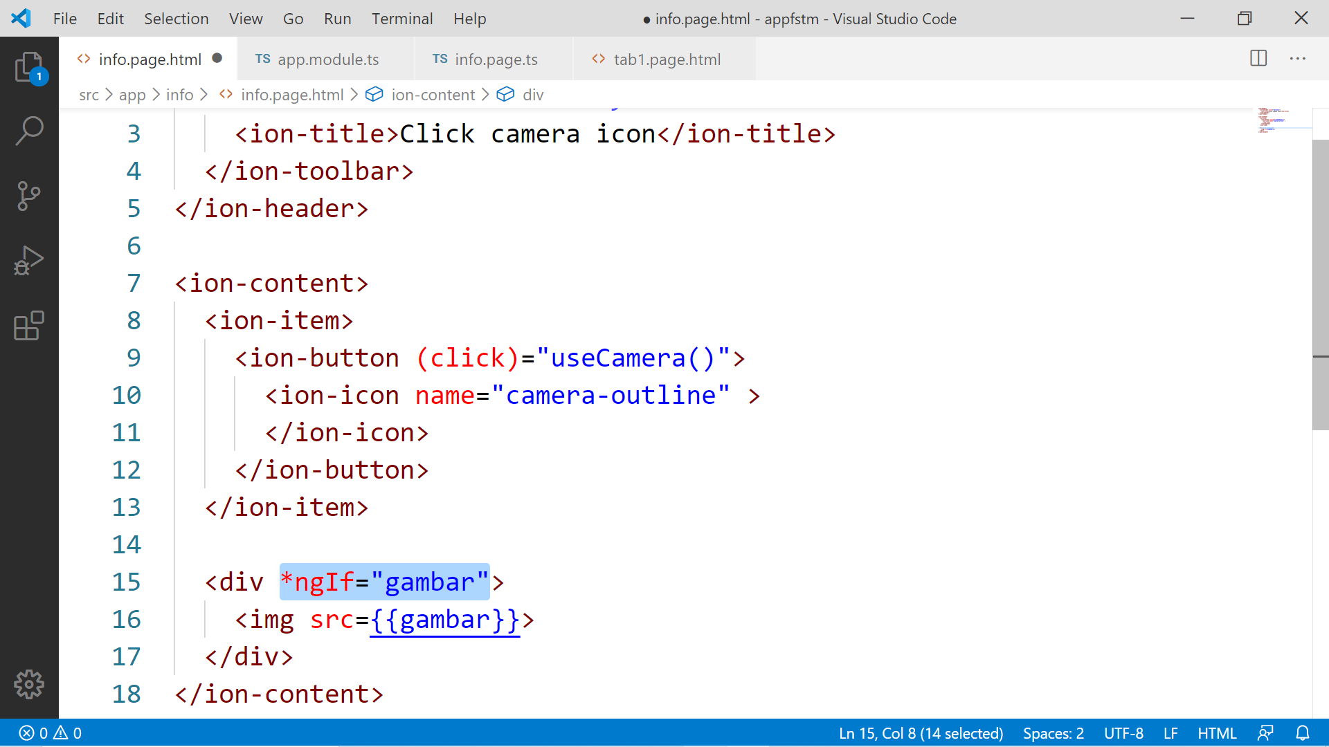

Slide 85
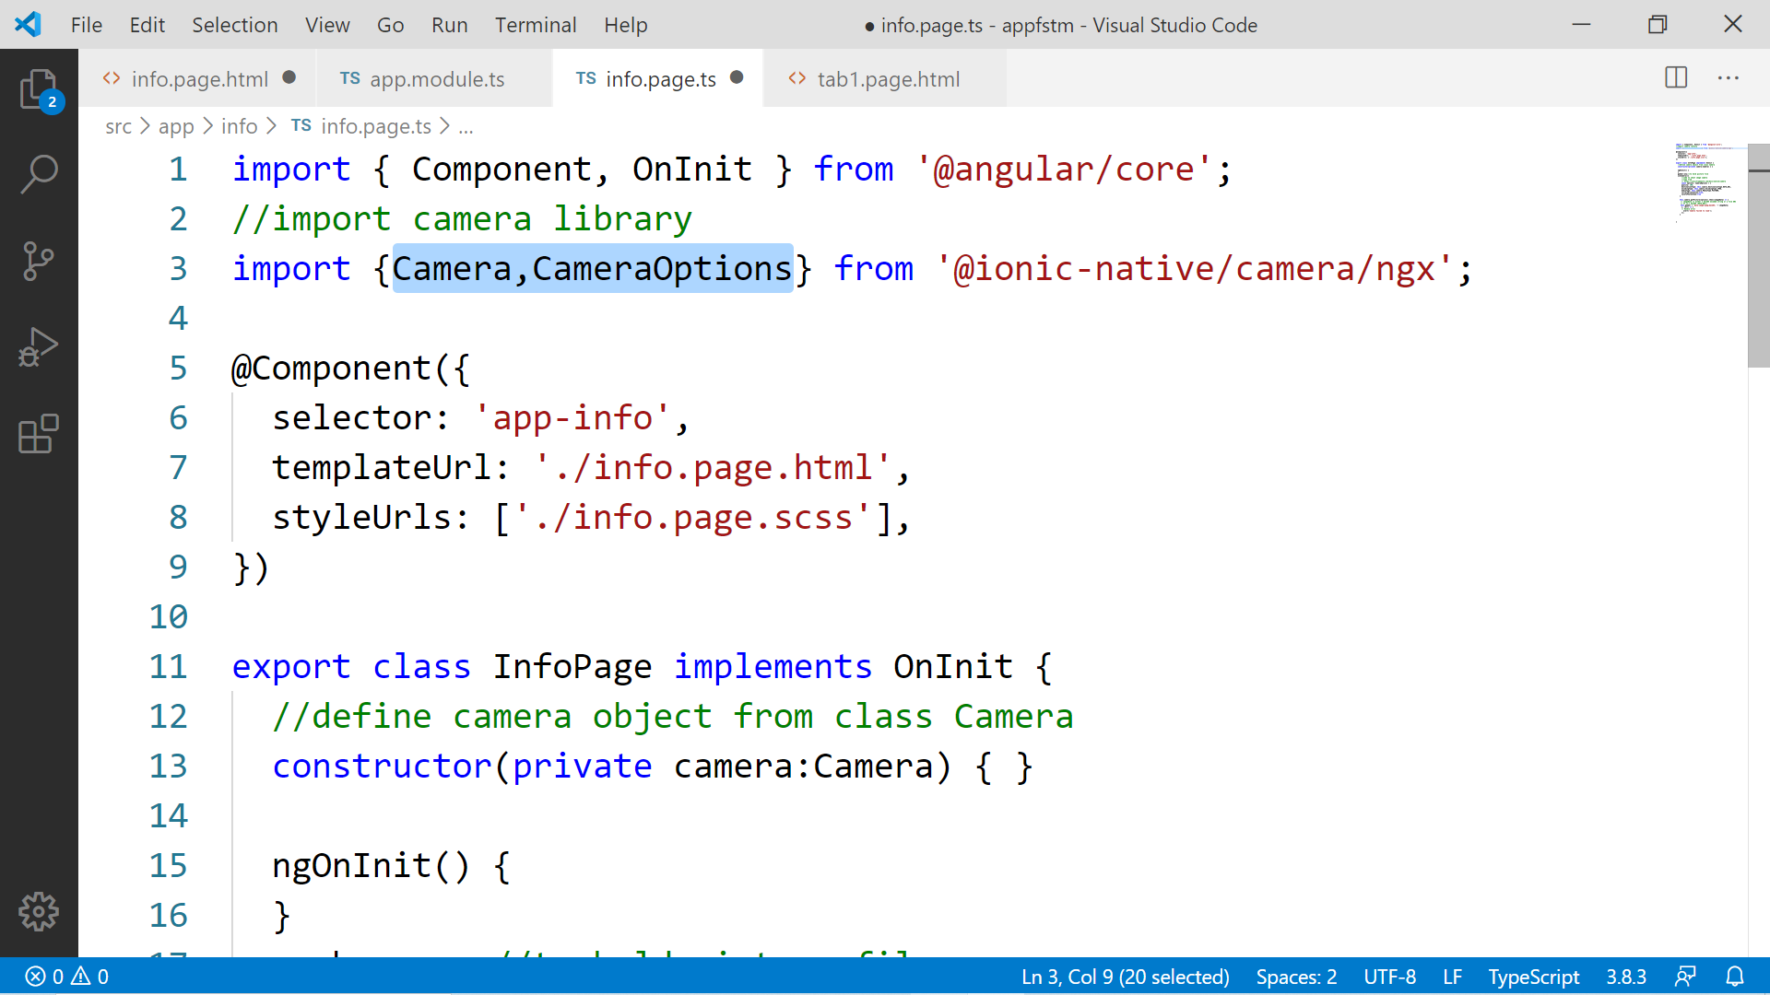

Slide 86
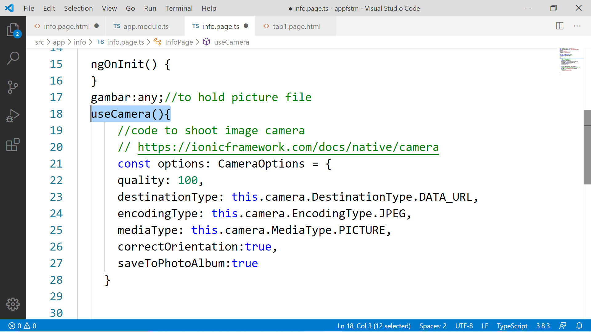

Slide 87
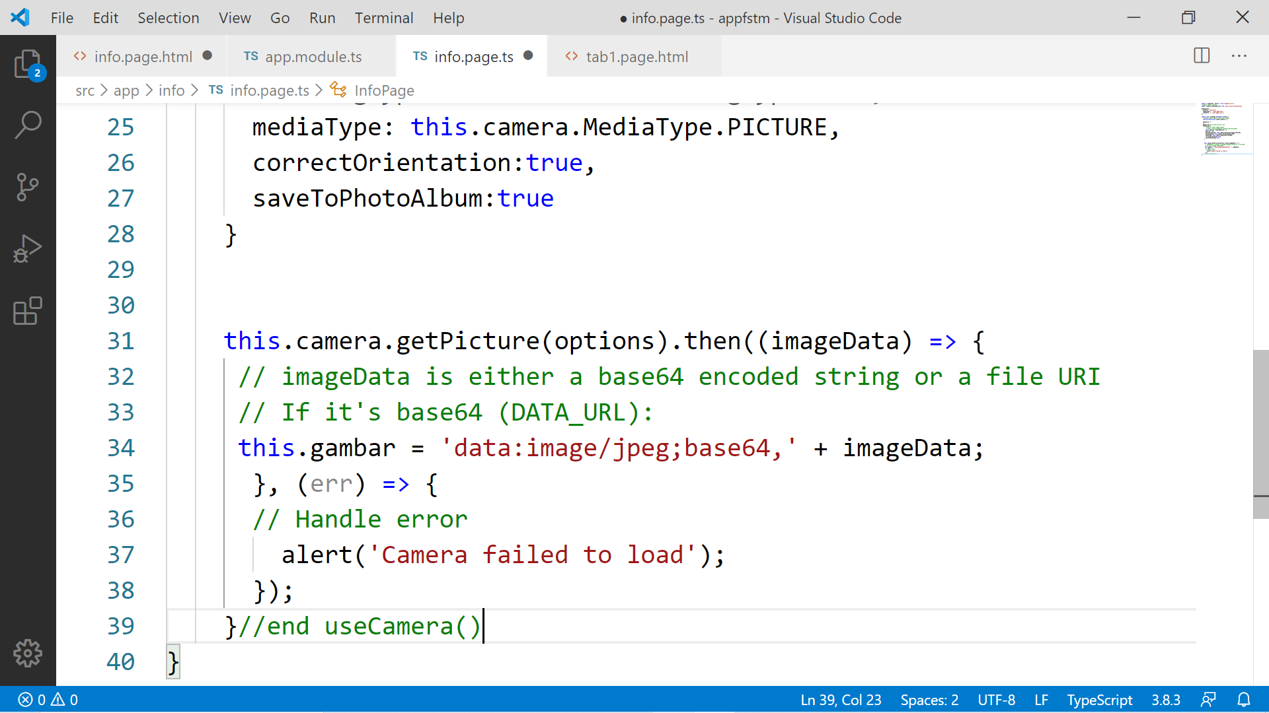

Slide 88
Migration Cordova to Capacitor - error: package android.support.v4.content does not exist
npm install jetifier
npx jetifier
npx cap sync android

Slide 89
Ionic Capacitor
https://ionicframework.com/resources/articles/capacitor-vs-cordova-modern-hybrid-app-development
runs modern Web Apps natively on iOS, Android, Electron, and Web

Slide 90
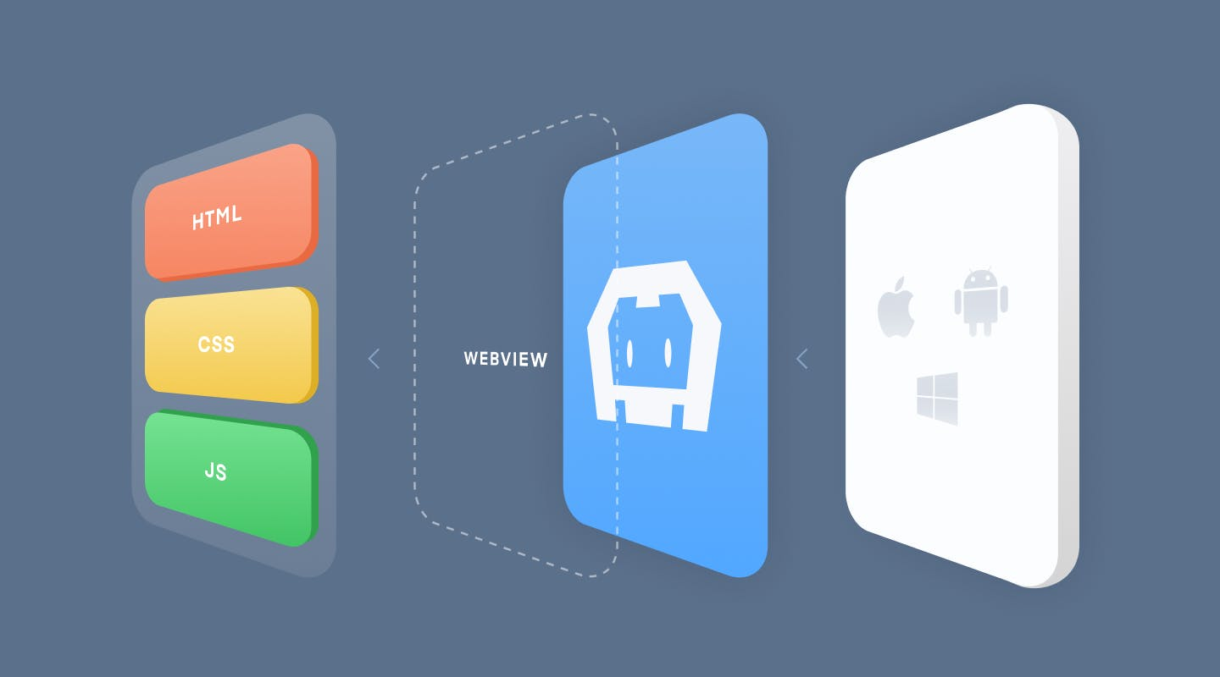
Previously we have CORDOVA

Slide 91
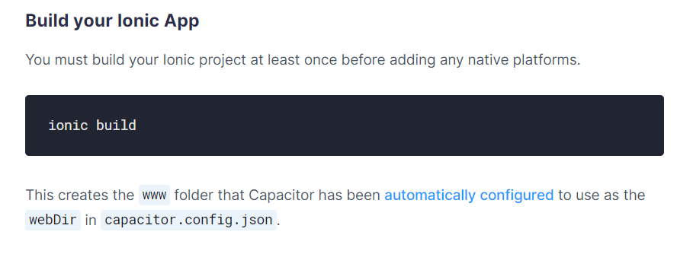
Ionic build

Slide 92
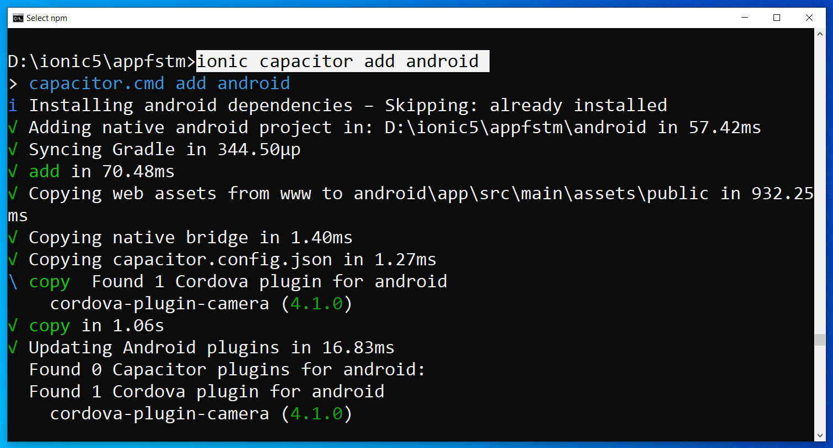
Run only once for each ionic project
To update Android project, execute
ionic build
npx cap copy

Slide 93
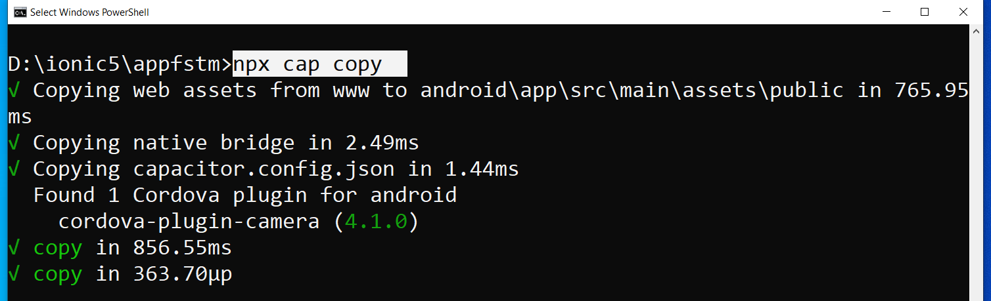
After finish installing the camera plug-ins

Slide 94
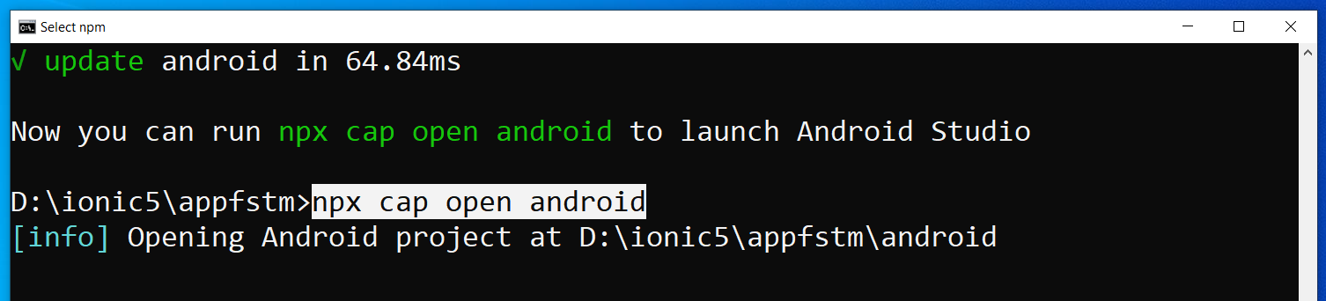
To open project on Android Studio

Slide 95
Codes & slides github.com/khirulnizam/ionic5

Slide 96
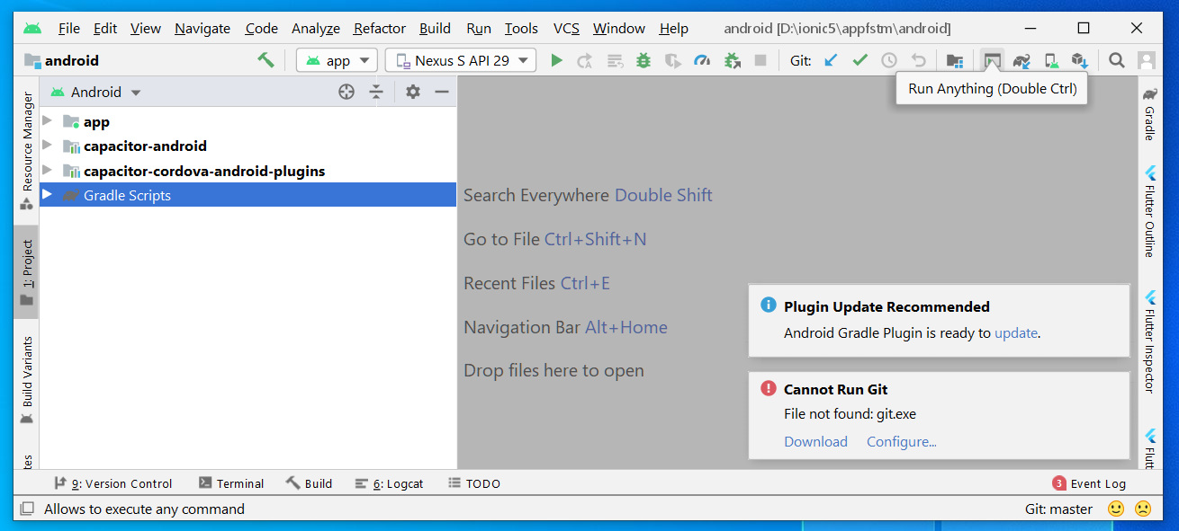
Open in Android Studio

Slide 97
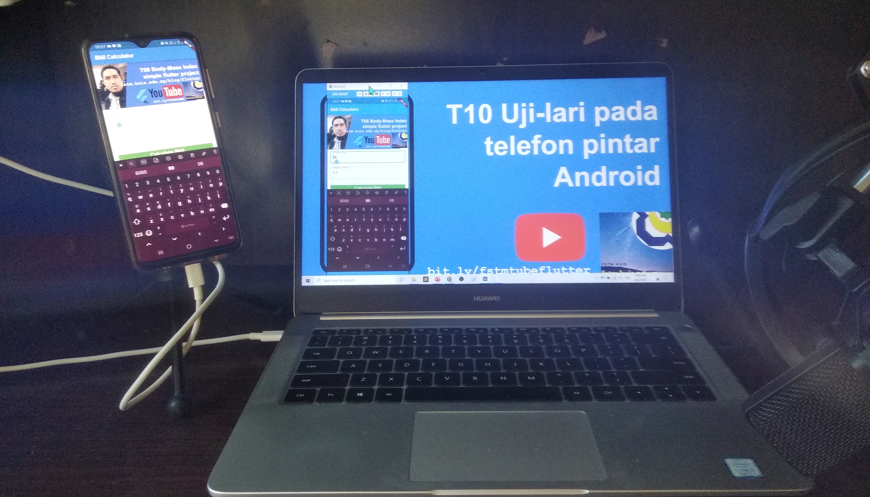

Uji-lari
apps pada
telefon
Android

Slide 98

Android Studio 3.6 & SDK developer.android.com/studio

Slide 99
Path settings (environment variables)
ANDROID_SDK_ROOT
JAVA_HOME

Slide 100
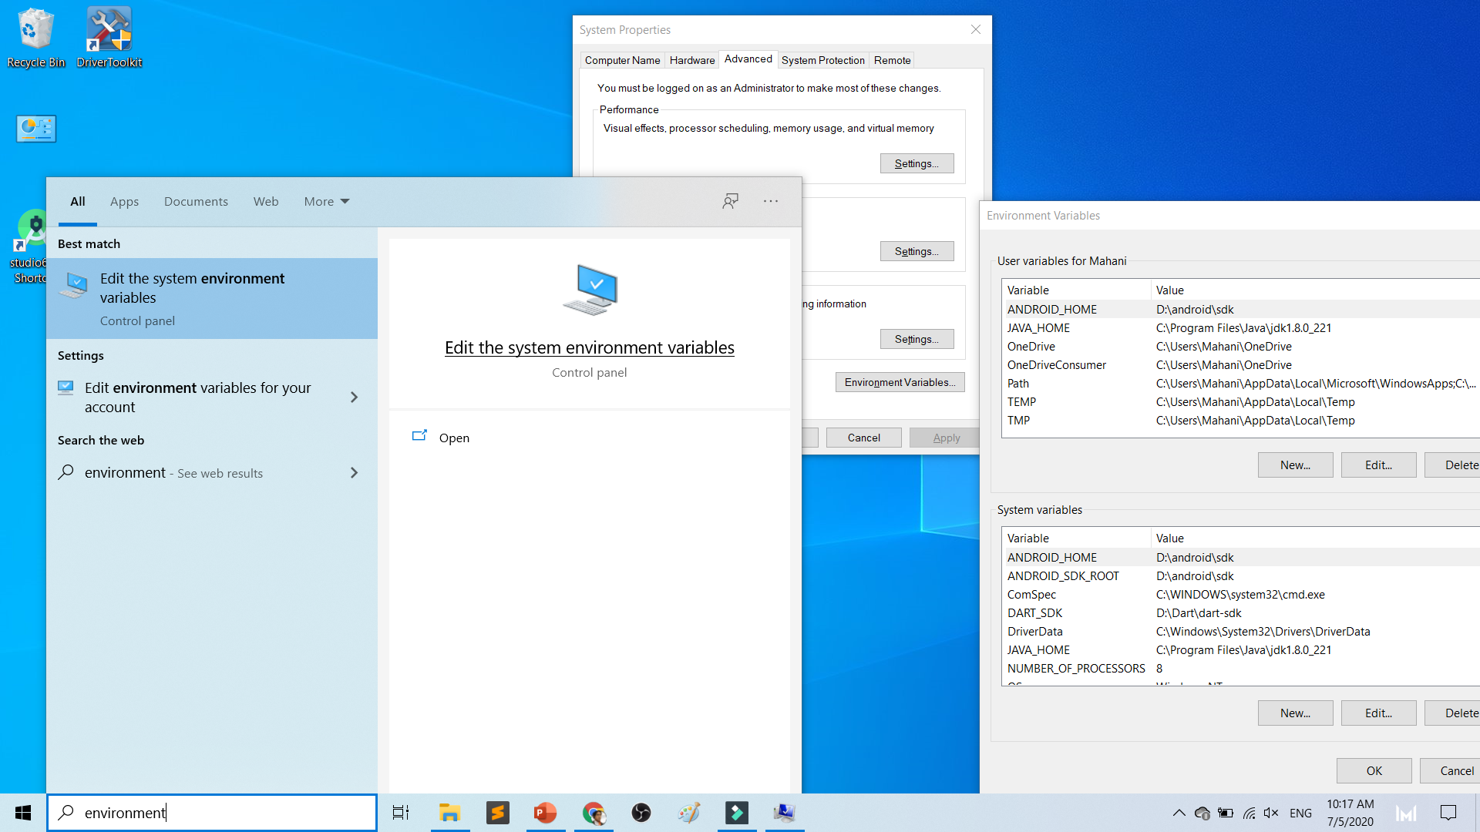

Slide 101
To deploy
Android Studio
Android SDK
Android Phone with USB Debugging enabled
ADB Bridge
USB Data-cable for Actual Device

Slide 102
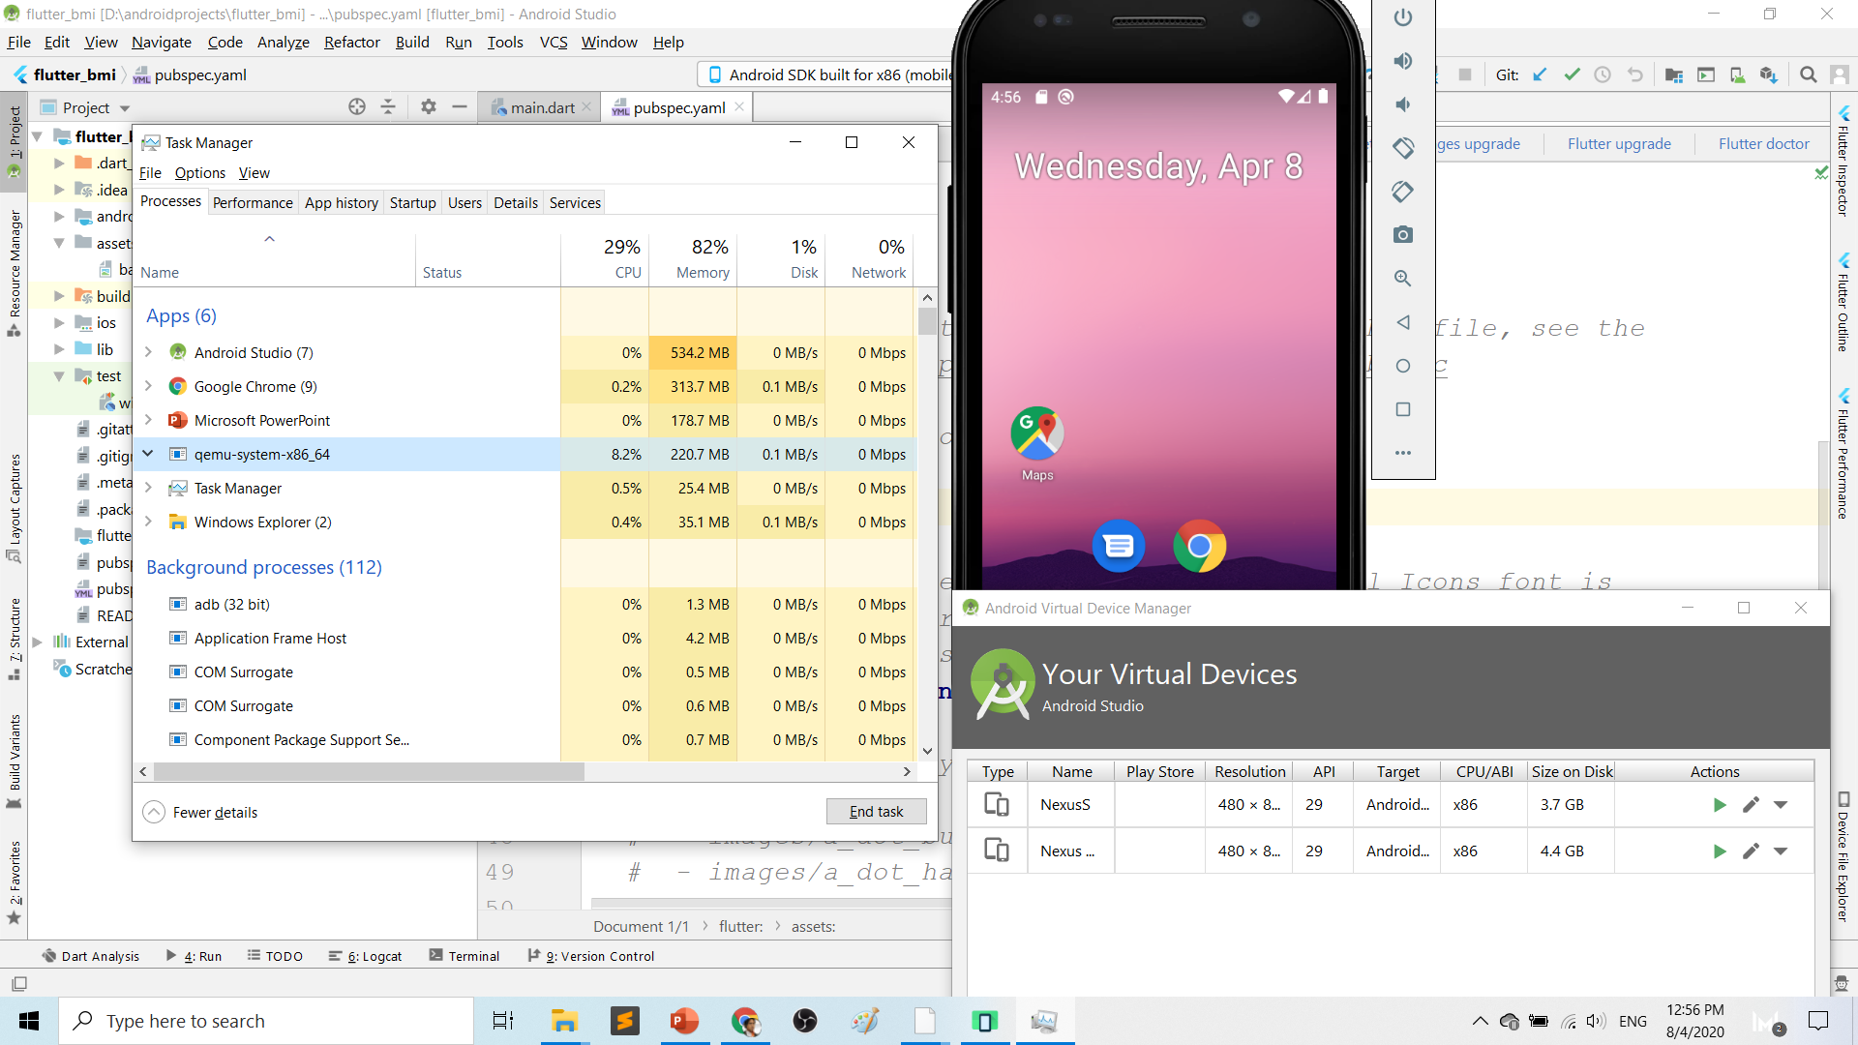
Play.google.com
What’s wrong with Android Studio & Emulator? RESOURCE-HUNGER

Slide 103
Requirements 1. USB debugging ON- phone 2. Connect USB Cable 3. Install ADB driver in PC

Slide 104

Play.google.com
Install universal debug driver
https://adb.clockworkmod.com/
Download & install universal debug

Slide 105



First time to on USB Debugging?
Developer options enable
Press 7X on build number
press 7x

Slide 106

First time Allow USB debugging?

Slide 107
Ionic build

Slide 108
Create Android project/platform ionic capacitor add android
Run only once for each ionic project
To update Android project, execute
ionic build
npx cap copy

Slide 109
Copy to www to android project npx cap copy

Slide 110
To open project on Android Studio npx cap open android

Slide 111
Open in Android Studio

Slide 112
Codes & slides github.com/khirulnizam/ionic5

Slide 113


T07 Pilihan Selection : if…else, ngIf
Codes & slides
github.com/khirulnizam/ionic5

Slide 114

Output overview

Slide 115
Create a new page
ionic g page login
(selection exercise)

Slide 116
[(ngModel)]
Example:
IN TYPESCRIPT:
username:any;
password:any;
IN HTML:
<ion-input [(ngModel)]= “username”>
</ion-input>
<ion-input [(ngModel)]= “password”>
</ion-input>
[(ngModel)] USED IN HTML to capture what is typed into input to TypeScript

Slide 117
*ngIf used in HTML
Usually used for array iterations
Example:
IN HTML
<div *ngIf= “ username==null ”>
Pls enter username
</div>
<div *ngIf= “ password==null ”>
Pls enter password
</div>
*ngIf USED IN HTML

Slide 118
*ngIf … else used in HTML
<div *ngIf="gambar; else noImageYet">
<img src="{{gambar}}">
</div>
<ng-template #noImageYet>
<img src="./assets/noimagep.png">
</ng-template>
*ngIf … else USED IN HTML

Slide 119
IF...ELSE IF...ELSE AND *ngIFStatements
Usually used for selection and/or filtering
Example:
if(username== null){
alert(“Pls insert username”);
}
else if(password==null){
alert(“Pls insert password”);
}
else {
alert(“Welcome user”);
}
IF...ELSE IF..ELSE USED IN TYPESCRIPT IS EXACTLY THE SAME AS JAVASCRIPT

Slide 120
Output

Slide 121

T08 Ulangan Repetition : for, foreach, ngFor

Slide 122
Codes & slides github.com/khirulnizam/ionic5

Slide 123
Create a new page
ionic g page irepeat
(repetition exercise)

Slide 124
For Loop and *ngFor
Usually used for array iterations. Example:
negeri[0]= “Johor”;
negeri[1]= “Melaka”;
negeri[2]= “N. Sembilan”;
negeri[3]= “Selangor”;
for(var x=0;x<negeri.length;x++)
{
console.log(negeri[x]);
}
This will output in the console all the items in the array
FOR LOOP USED IN TYPESCRIPT

Slide 125
For Loop and *ngFor
Usually used for array iterations
Example:
IN TYPESCRIPT
negeri[0]= “Johor”;
negeri[1]= “Melaka”;
negeri[2]= “N. Sembilan”;
negeri[3]= “Selangor”;
IN HTML
<ion-item *ngFor= “let item of negeri”>
{{ item }}
</ion-item>
This will output all the negeris in HTML
*ngFor LOOP used in HTML

Slide 126

T09 Navigasi (navigation with parameters)

Slide 127
PARAMETERS
PAGE 1
(irepeat)
PAGE 2
(displayparams)
Nama: Kerul
Poskod: 43000
Negeri: Selangor
Nama: Kerul
Poskod: 43000
Negeri: Selangor
Nama: Kerul
Poskod: 43000
Negeri: Selangor

Slide 128
Navigation with Parameters
1. Using Router
TO SEND VALUES (CANNOT SEND OBJECTS)

Slide 129
2. Using Services
Navigation with Parameters
*TO SEND OBJECTS

Slide 130
Using ActivatedRoute
On app-routing.module.ts add param name, example /:id
Add /id when navigating
To get param
import {Router} from ‘@angular/router’
public route:Router
let the_id=this.route.snapshot.params.id

Slide 131
Using Services

Slide 132
USING SERVICES
HOME
SERVICES:
Functions
createUser(email, password)
{
…
}
loginUser(){
…
}
listUsers(){
…
}
DAFTAR
LOGIN
OTHER SERVICES

Slide 133
Using SERVICES
Services can be used globally
Can be used repeatedly
By different pages/other services

Slide 134
Generate a service
ionic g service service/data
Import Service and call from page ts

Slide 135


Slide 137


shareMasjid

Slide 138

& Firestore Auth

Slide 139


t10 Firebase (setup)

Slide 140

github.com/khirulnizam/ionic5 wasap.my/60129034614

Slide 141

Serverless option using Firebase
Serverless computing is a method of providing backend services on an as-used basis
A Serverless provider allows users to write and deploy code without the hassle of worrying about the underlying infrastructure
Scalable - the serverless vendor handles all of the scaling on demand
Simplified backend code
Quicker turnaround

Slide 142

JSON Concept
JSON: JavaScript Object Notation.
JSON is a lightweight data-interchange format
JSON format is text only, it can easily be sent to and from a server.

Slide 143

Play.google.com
JSON format example as applied in Firebase

Slide 144

Google Firebase : Console
https://console.firebase.google.com/

Slide 145

Google Firebase : Create new project

Slide 146

Google Firebase : Project name
sharefstm

Slide 147

Google Firebase : Accept T&C

Slide 148

Google Firebase : Project ready and continue
makanapps

Slide 149

Google Firebase : Realtime database, automatic scaling

Slide 150

2
1
3

Slide 151

1
2

Slide 152

Google Firebase : Enable test mode

Slide 153

Google Firestore : add Firebase to app

Slide 154

Web Apps Firebase Configuration : Copy the highlighted

Slide 155

T11 Auth + Register
(daftar pengguna)

Slide 156

Create new Ionic project
ionic start sharefstm blank
Page 1: home

Slide 157

Filename src/app/home/home.page.html

Slide 158
Paste the Firebase configuration to environtment.ts
In environment.ts
…
export const environment : {
production: false,
firebaseConfig: {
apiKey: "AIzXXXXXXXXXXXXXXXWZMPN90HFrp4",
authDomain: "test-projeXXXXXXX.firebaseapp.com",
databaseURL: "https://test-projeXXXXXXX.firebaseio.com",
projectId: "test-projeXXXXXXX7",
storageBucket: "test-projeXXXXXXXX.appspot.com",
messagingSenderId: "446XXXXXX105"
}
};
…

Slide 159
Install AngularFirebase plugins
npm install firebase @angular/fire --save

Slide 160
Filename src/app/app.module.ts
//src/app/app.module.ts
…
//firebase & auth
import { AngularFireModule } from '@angular/fire';
import { AngularFireAuthModule } from '@angular/fire/auth';
import { environment } from '../environments/environment';
…
imports: [BrowserModule, IonicModule.forRoot(), AppRoutingModule,
//firebase & auth
AngularFireAuthModule,
AngularFireModule.initializeApp(environment.firebaseConfig),
…

Slide 161
Create globally accessible functions in folder services
ionic g service services/firebase
import { AngularFireAuth } from '@angular/fire/auth';
…
export class FirebaseService {
constructor(
private afAuth: AngularFireAuth
) { }
registerUser(email, password) {
return new Promise<any>((resolve, reject) => {
this.afAuth.createUserWithEmailAndPassword(email, password)
.then(
res => resolve(res),
err => reject(err))
})
}

Slide 162

Add another page
ionic g page daftar
Page 2: daftar

Slide 163

Filename src/app/daftar/daftar.page.html

Slide 164

Filename src/app/daftar/daftar.page.html

Slide 165

Filename src/app/daftar/daftar.page.ts

Slide 166

Filename src/app/daftar/daftar.page.ts

Slide 167


Slide 168
T12 Auth + Login
(pengesahan pengguna)

Slide 169
github.com/khirulnizam/ionic5 wasap.my/60129034614

Slide 170
Add globally accessible functions in folder services
ionic g service services/firebase
import { AngularFireAuth } from '@angular/fire/auth';
…
loginUser(email, password) { //function loginUser
return new Promise<any>((resolve, reject) => {
//authenticating with email & password
this.afAuth.signInWithEmailAndPassword(email, password)
.then(
res => resolve(res), //successful
err => reject(err)) //rejected
})
}//end loginUser
…

Slide 171

Add another page
ionic g page login
Page 3: login

Slide 172

Filename src/app/login/login.page.html

Slide 173

Filename src/app/login/login.page.html

Slide 174
Filename src/app/login/login.page.ts
…
cubalogin(email, password) {
this.fService.loginUser(this.email, this.password)
.then(res => {
console.log(res);
this.errorMessage = "";
//this.navCtrl.navigateForward('/dashboard');
}, err => {
this.errorMessage = err.message;
})
}//end cubalogin
…

Slide 175
github.com/khirulnizam/ionic5 wasap.my/60129034614

Slide 176


T13 Rekod Baharu
(insert new record)

Slide 177
github.com/khirulnizam/ionic5 wasap.my/60129034614

Slide 178

Carian

Slide 179
github.com/khirulnizam/ionic5 wasap.my/60129034614

Slide 180

T15 Kemaskini
(update record)

Slide 181
github.com/khirulnizam/ionic5 wasap.my/60129034614

Slide 182

T16 Padam
(delete record)

Slide 183
CRUD

Slide 184



Jana APK
(signed release)

Slide 185
Muatnaik Apps ke
Google Playstore
Fblive FSTM KUIS
11pg 6Nov 2020 (Jumaat)

Slide 186

←App ID

Slide 187

Play.google.com
Register for a developer ID
USD25 for life.
Another consideration: you need to pay through Google Wallet, using a credit card. https://play.google.com/apps/publish/

Slide 188
Playstore Graphic Materials
high-res icon. (size 512px x 512px)
Featured graphic. (size 1024px x 500px)
at least 2 non-Android TV screenshots. (2 screenshot images. Min length for any side: 320px)

Slide 189

Samples of graphic materials & signed bundle/APK

Slide 190
Graphic materials github.com/khirulnizam/ionic5

Slide 191



Slide 192


Ionic vs Flutter

Slide 193


Icon
launcher
& Splash
screen

Slide 194
https://ionicframework.com/docs/cli/commands/cordova-resources
Graphic materials
resources/icon.png (with size 1024x1024)
resources/splash.png (with size 2732x2732)

Slide 195

https://ionicframework.com/docs/cli/commands/cordova-resources
Graphic materials
resources/icon.png (with size 1024x1024)
resources/splash.png (with size 2732x2732)
(create folder resources)
splash.png
(2732x2732px)
icon.png (1024x1024px)

Slide 196
https://ionicframework.com/docs/cli/commands/cordova-resources
Commands - CLI
ionic cordova resources

Slide 197

Ionic cordova resources
(created after ionic cordova resources)

Slide 198
In file package.json add
"scripts": {
…
"resources":"cordova-res --skip-config --copy",
…
}

Slide 199
Build, copy and open in Android Studioclz
ionic capacitor add android (sekiranya belum)
ionic build
npx cap sync android
npm install capacitor-resources -g
cordova-res --skip-config --copy
npx cap open android
Run apps in Android Studio
cordova-res to copy icon/splash from resources to Android project res folder

